Slide 1

BWD & Hyndburn Good Practice Example
The Power of “Lancashire Talking”
Steve Rides, Local Policing Inspector for Hyndburn District

Slide 2
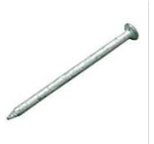
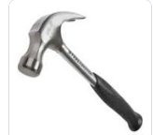
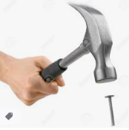
The Importance of Effective Use of Information
(Its not just about what you've got it’s what you do with it that matters)
Nail = Community information – Alone has a use but is not effective
Hammer = Targeted Activity
Hammer & Nail
Put them together and it now becomes effective

Slide 3
Simple BUT Effective………….
Identify Top Community Issues
Send a targeted message to the interest group
Monitor and respond to the replies
Take Action
Feedback the results

Slide 4
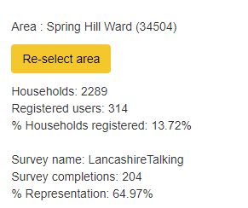
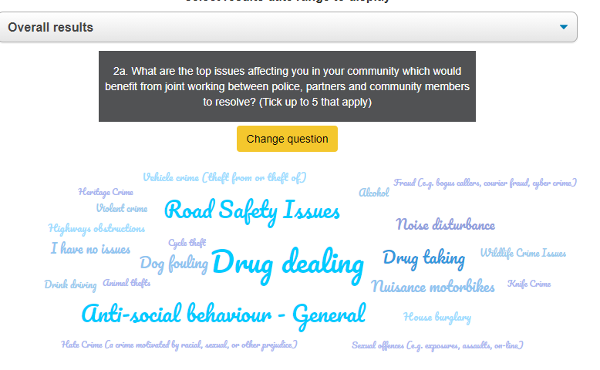
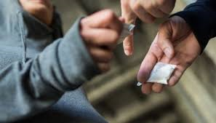
Community Priority Springhill
Drug Dealing

Slide 5
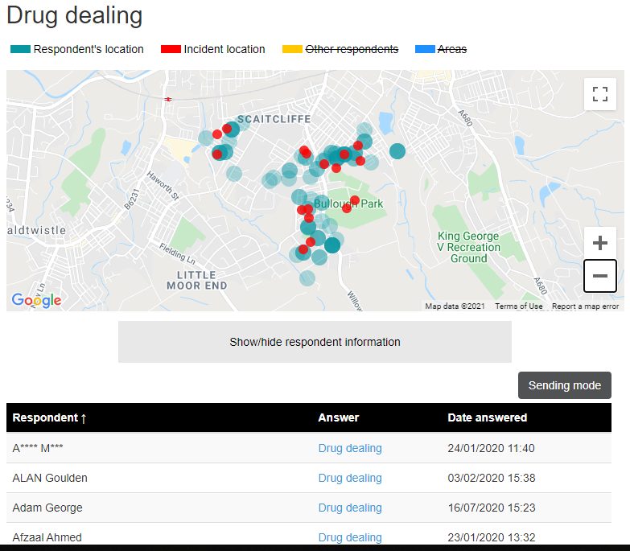

Targeted Action – Tackle Community Issues – Involving the local community to help solve the problem

Slide 6
Targeted Message Sent
Drug dealing and drug taking
Local news
Lowest priority message
10/12/2020 18:44:00
Email
Dear {FIRST_NAME}
Areas around Accrington that have been identified with your support are constantly monitored. Information on cars and people have also been logged in our systems.
It is with your continued support that we are able to tackle these problems in our communities.
We are out and about tonight covering the hot spots that have been reported and hopefully we will be able to tackle or at least disrupt these offenders..
If anyone has any drug related issues that they need to report please call it through on 101. You can also simply reply to this message with full discretion.
Thanks for your continued support
Mat

Slide 7
Community Response
From FOzia Ali
10/12/2020 19:17:38
E-mail Reply
Hi my neighbour at no 89 ormerod street have canabis plants i can hear the heating which is very loud and it smells aswell.
This is happening since last year I have complained to the police and crime stoppers online aswell.
Nothing has been done.
Reply from Mathew Gill
10/12/2020 19:49:05
E-mail Reply
Hi
As a neighbourhood police team member we support local communities and we have the ability to investigate it across our teams.
I will check it out and pass it onto the rest of the team and hopefully we can shut it down..
Thanks for letting me know.
Mat
Note added by Mathew Gill

Slide 8
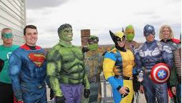
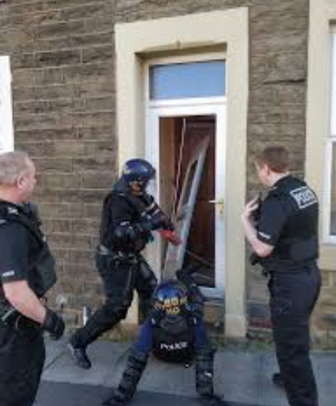
Several Days later….. Hyndburn NPT Spring in to Action…Led by the NPT PS (Leadership is Key)

Slide 9
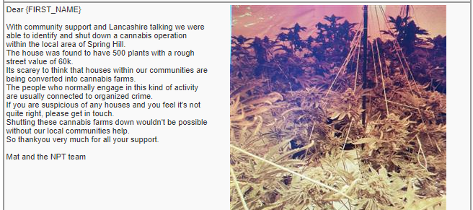
And the result was……
Cannabis Farm Located / 1 male arrested
= 1 Happy Neighbour!!

Slide 10
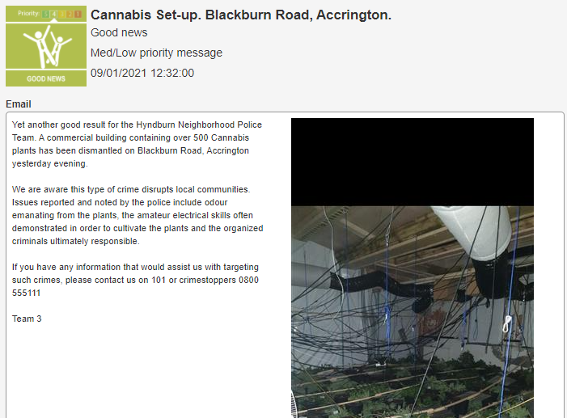
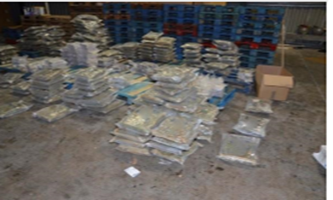
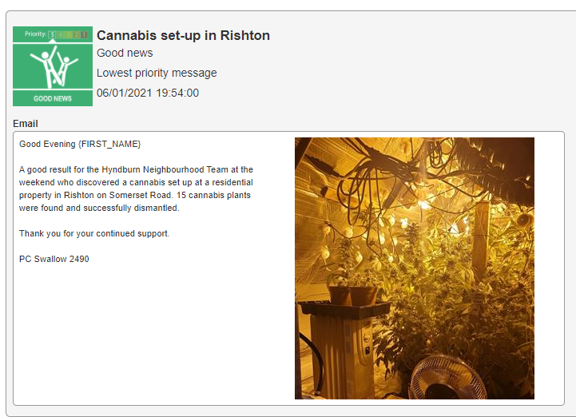
Approximately £5million of Cannabis recovered in the last 6 months by Hyndburn NPT…..
Meeting the “Community Priority”
Evidence that Hyndburn NPT are now focused and motivated on Community Issues

Slide 11
Lancashire Talking – It really does work
Feedback from the Community…..
From Sue Rees
11/01/2021 11:27:43
E-mail Reply
Fabulous news. Thanks for continuing to fight the war against drugs. 👏🏻👏🏻👏🏻
From Barry Fielding
09/01/2021 14:02:44
E-mail Reply
Well done keep up the good work 👍
From Sandra Parker
07/01/2021 10:23:13
E-mail Reply
Well done again... Goodness, there's a lot of money about if people are actually still buying this absolute stinking rubbish at this time, when people are out of work and can't afford food for the table!
From Adrian White
09/01/2021 14:32:54
E-mail Reply
Well done and thank you for all you do to tackle problems in the community.
From Dawn Stubbins
06/01/2021 22:05:52
E-mail Reply
Evening another great result. Thankyou keep up the good work

Slide 12
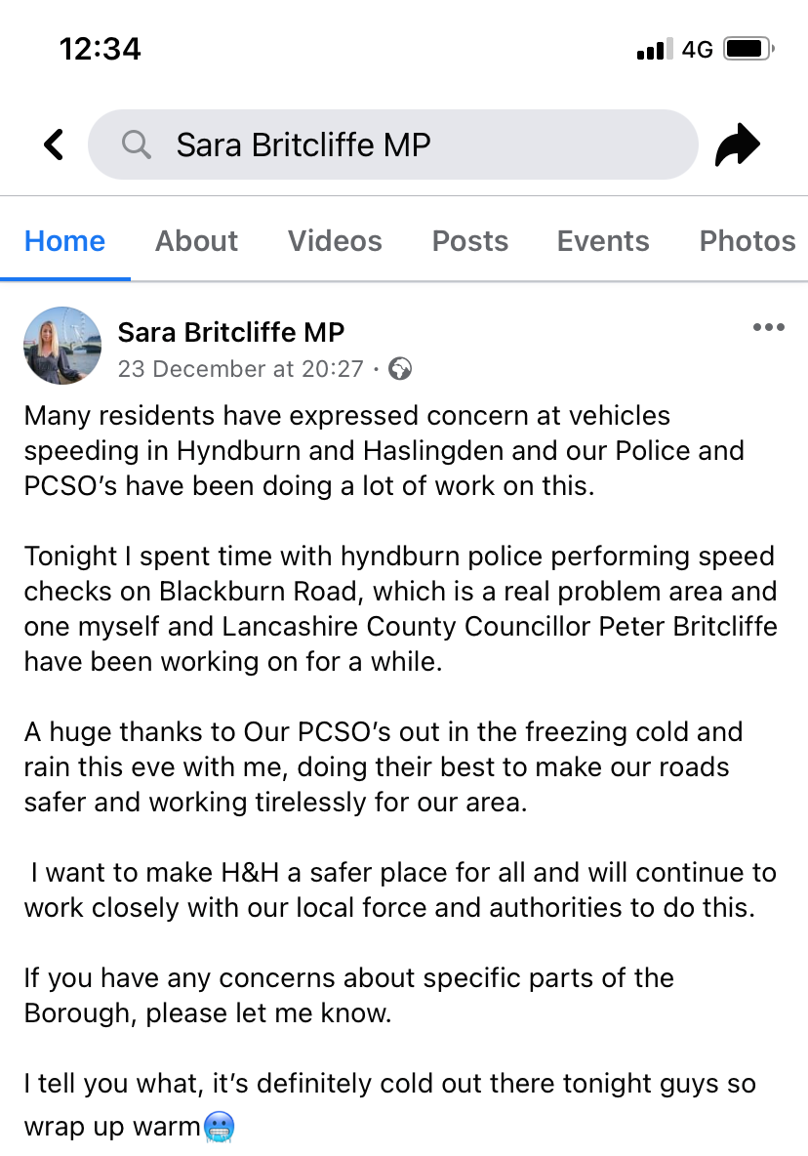
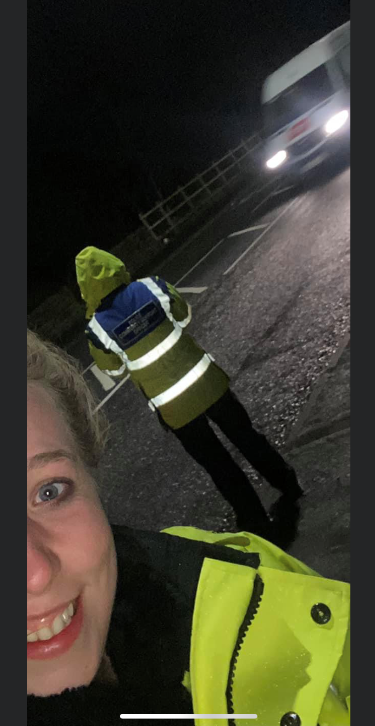
LT Success
Leadership is Key – Internal AND External
MP Full Support
Local Councilors
Standing Agenda item on CSP – Involve Partners in solutions
(Poo Dunnit)

