Slide 1

Delivering the Neighbourhood Matters Priority Survey
Key requirements to find and deliver the Neighbourhood Alert, Enhanced Module, Priority Survey
Mar 2023

Slide 2

Why Bother?
Public confidence, so what? (what are the benefits for you?)
More intel to catch criminals
Drive engagement: Action when you need it
Connect with local contacts
Drive Neighbourhood Watch Activity: Active Citizens

Slide 3
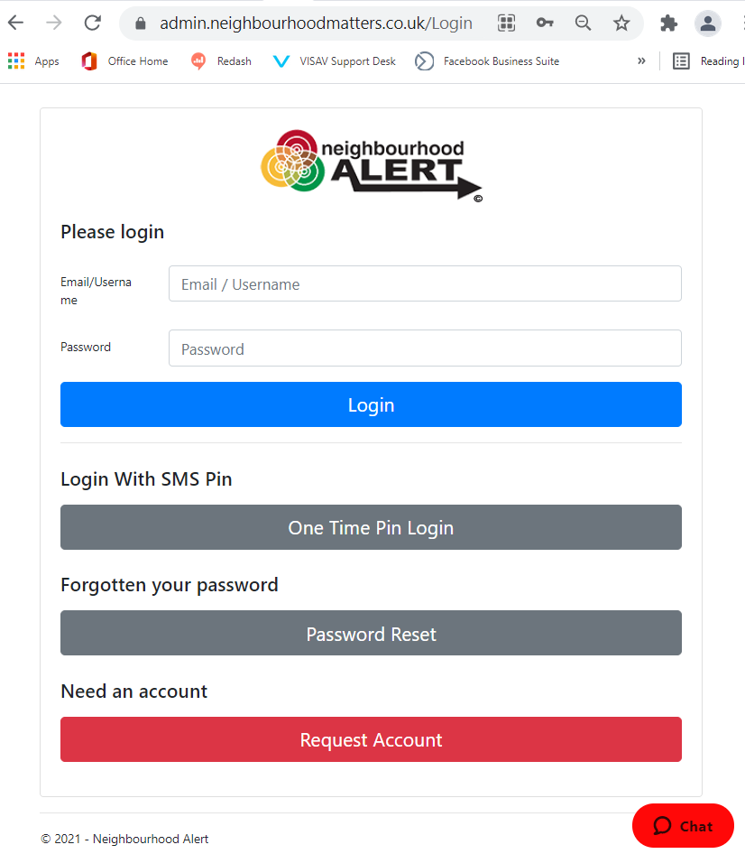
1) Ensure you have access to “Rapport”
Rapport is the secure admin area used to access the Neighbourhood Alert database from a mobile device
You will need to request an admin account (if you don’t already have one), by going to: https://admin.NeighbourhoodMatters.co.uk/ and clicking the red ”Request Account” button

Slide 4
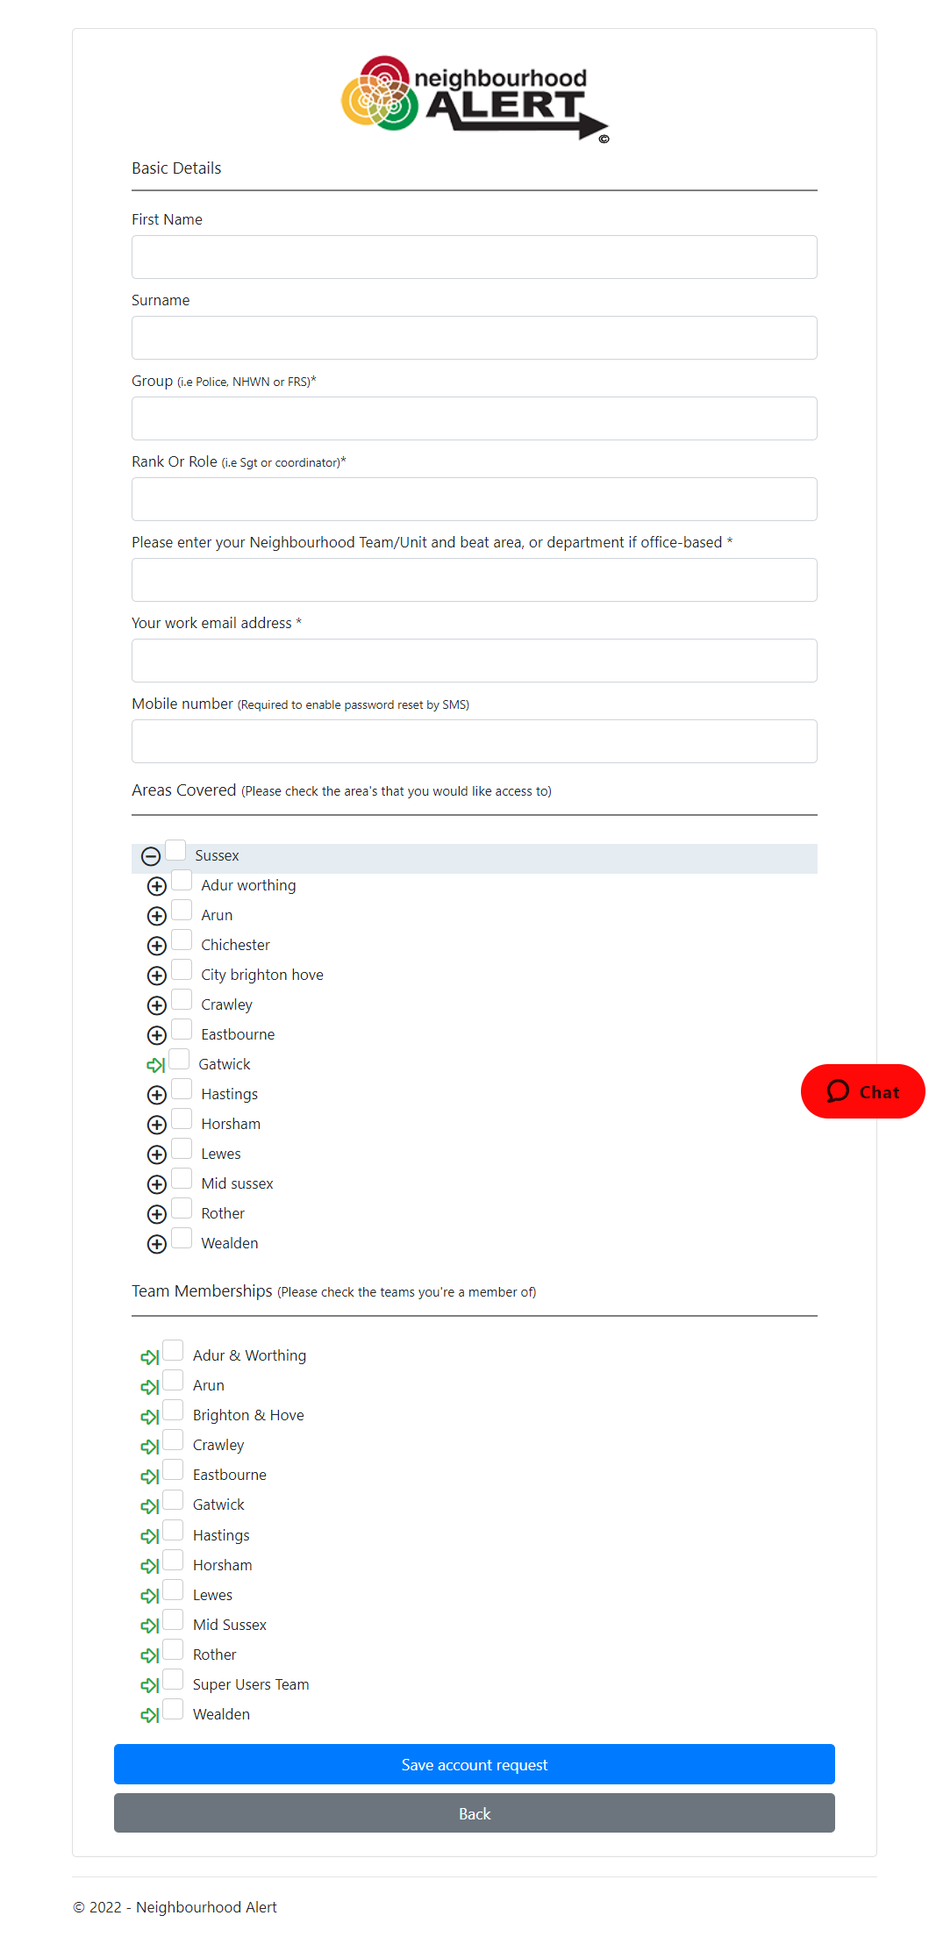
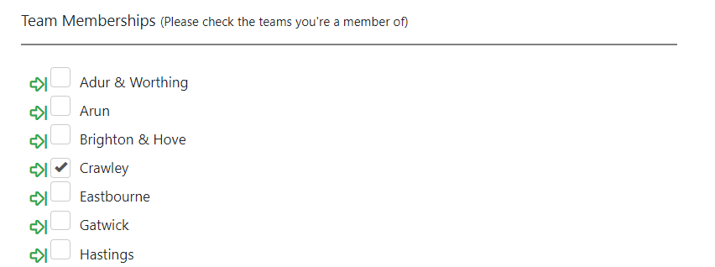
Request an account
Complete the form with your details (no shared email addresses etc)
In “Areas Covered” drill the options down using the + symbols and tick the areas you cover.
Under “Team memberships” tick the Team/Department you work in or drill down the SNTs and select each bottom level area you usually cover.

Slide 5
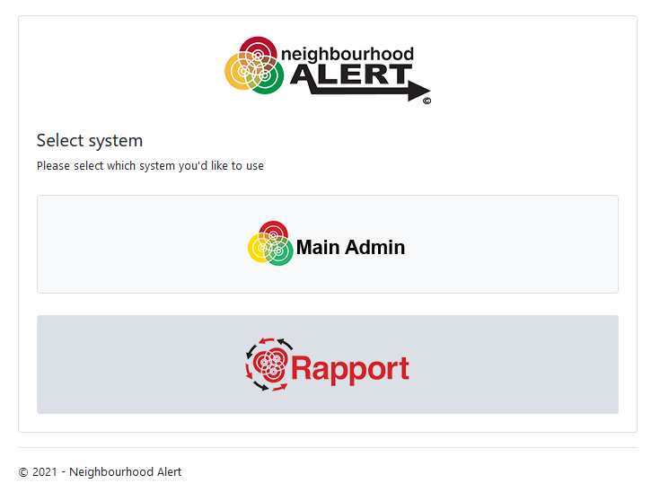
Select Rapport
Once your application is approved, follow the link in the email confirmation and set up your own memorable words and password.
Find the Admin site by going to: https://admin.NeighbourhoodMatters.co.uk
Click on the “Rapport” button

Slide 6

Aims
Give you data in the field
Make your time count
Make every contact with the public count
Start a long-term relationship with the public
Inspire confidence
Drive active citizenship

Slide 7

Tasks #1
Log in to Rapport
Find the Help Centre
Update your profile picture
Set an easy alternative login name

Slide 8
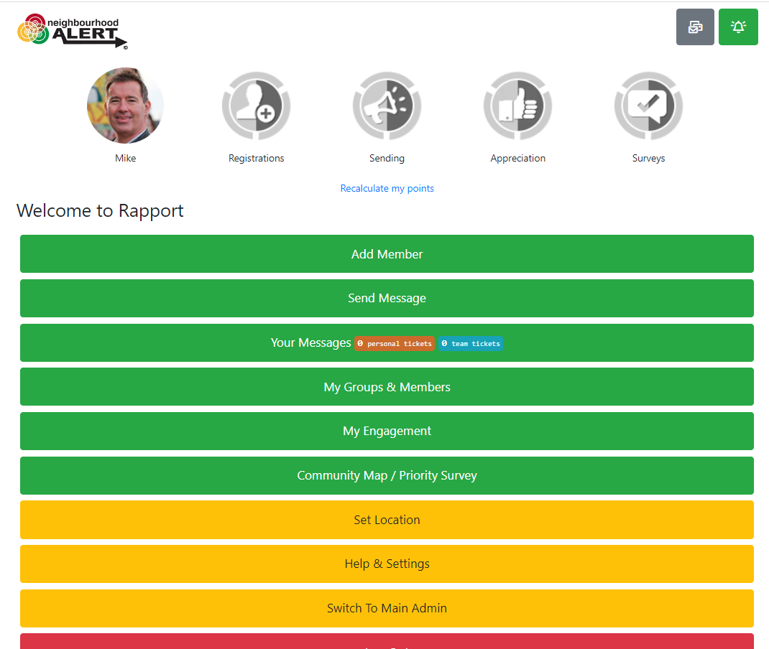
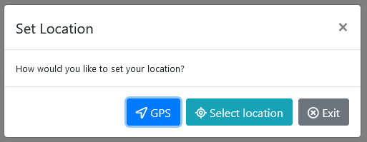
Set Location
On the mobile device you are going to use, click the “Set Location” button
If you are on site, use GPS, otherwise, click the “Select location” option

Slide 9
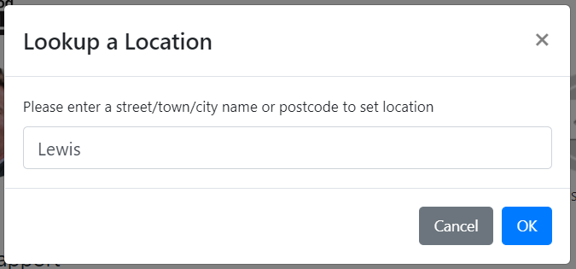
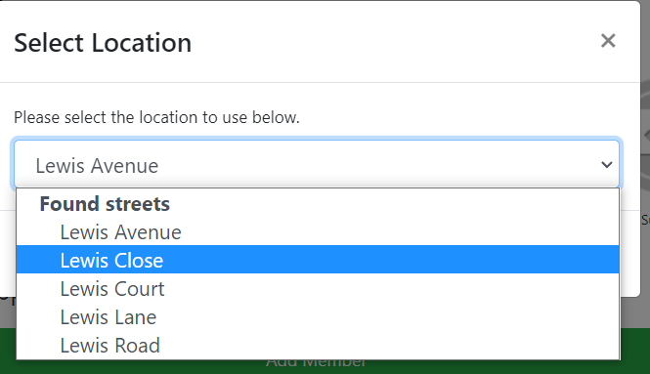
Set location
Type the location to search and click OK
The local Ward area or street should appear, click OK
Confirm with OK on the map view

Slide 10
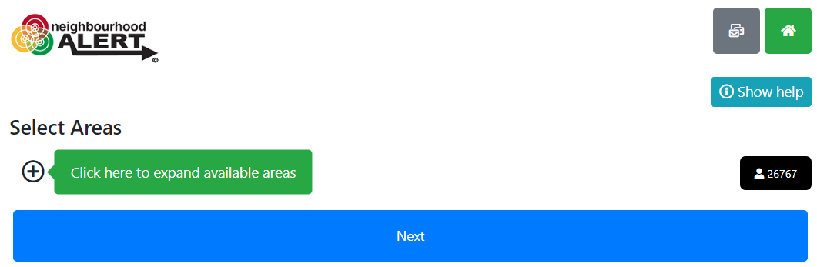
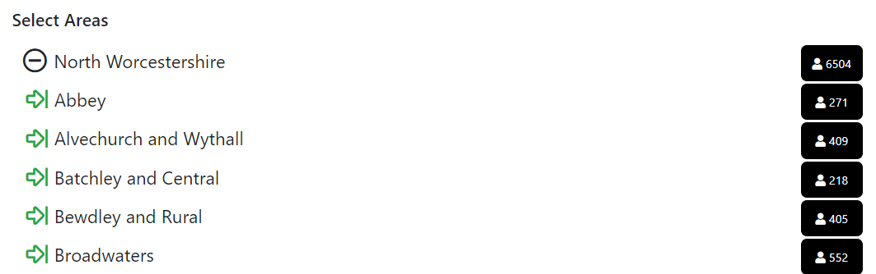
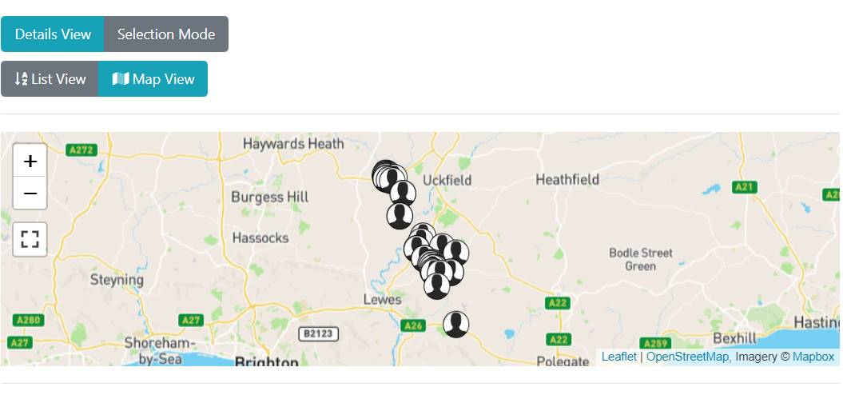
Find and map the Current Member coverage
Click on “My Groups and members”
Click “View Any Groups Memberships”
Drill down to a specific area using the small black +
Observe the total number of people in each area and select them by clicking on the black button(s)
Turn the selected area green and click the “Next” button
Scroll all the way down the filter options and click the blue “View list of people” button at the bottom
The next screen shows a small map and lists the nearest 500 people to your set location. Click the “Map view” button
Use the Full screen icon to see a larger map and drag this around to see the current coverage of registered users.

Slide 11
Tasks #2
Find the guidance on sending a message
Add yourself as an end user
Send a message

Slide 12

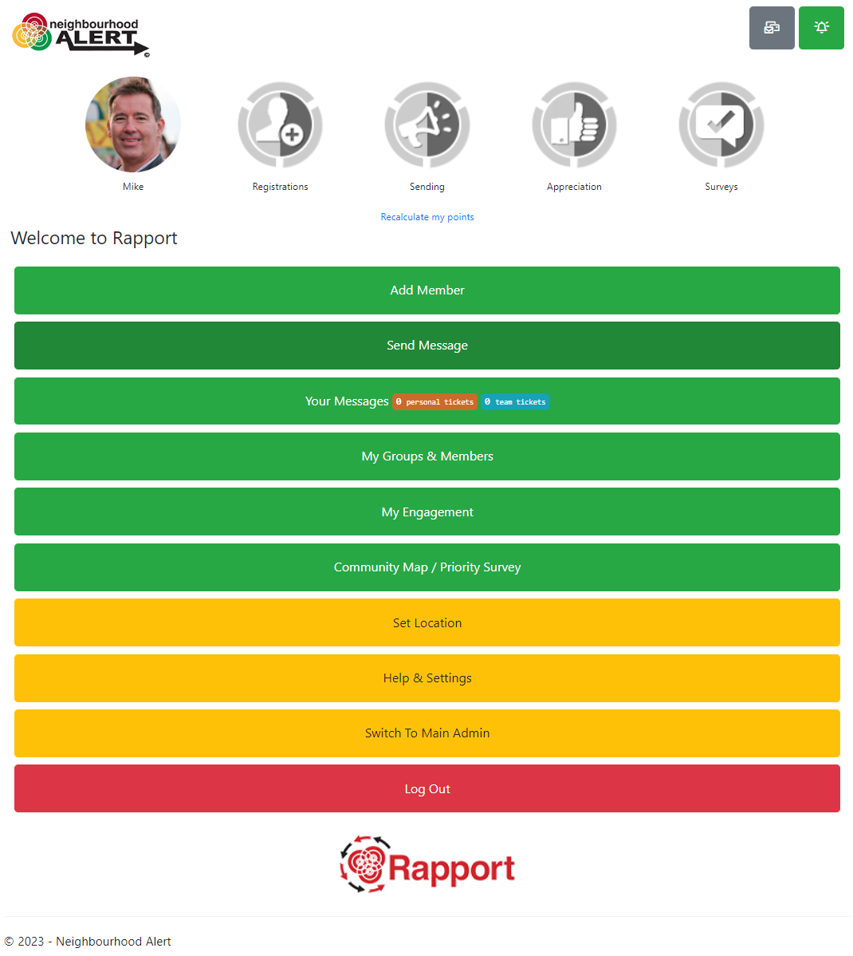
Send A Message

Slide 13
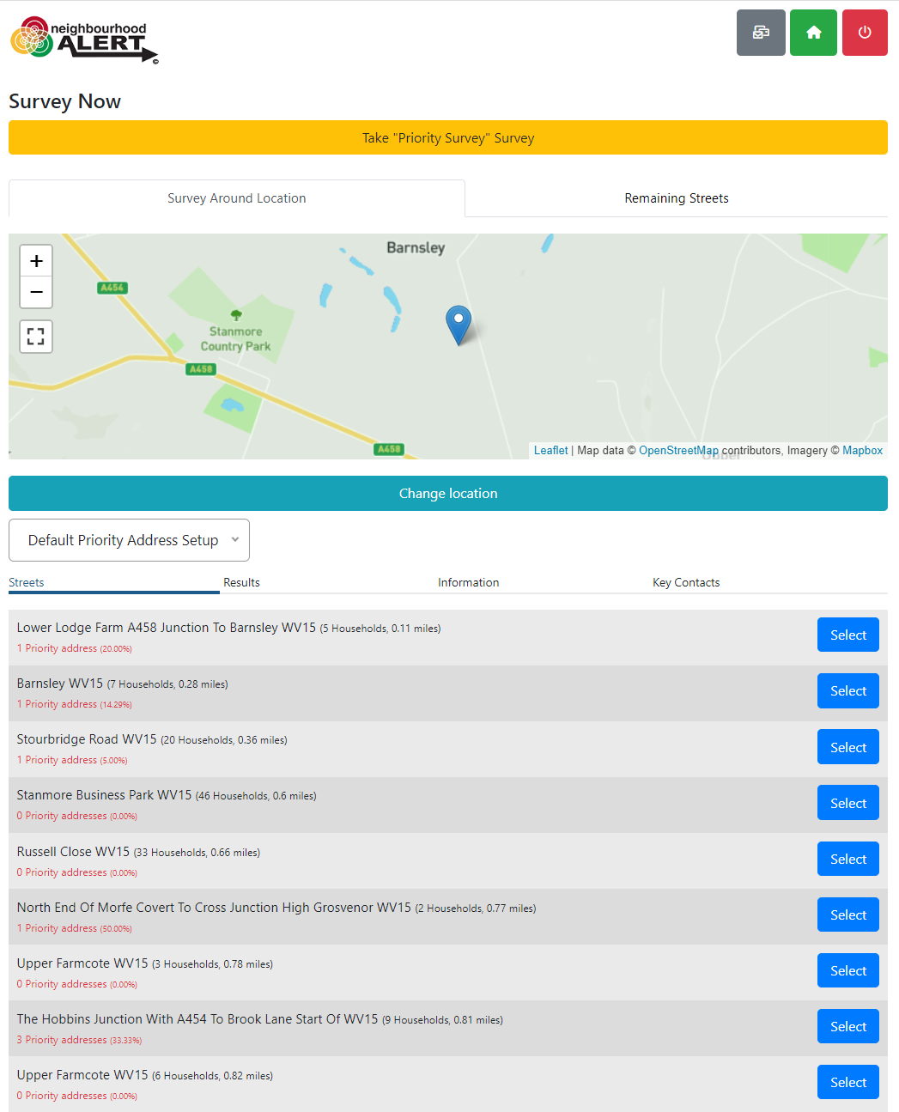
Info At Your Fingertips
Street Lists (Default and Priority ones)
Survey Results
Demographic information
Key Contact lists

Slide 14

Find Addresses and deliver the survey
On the Home screen (accessed with the icon in the top right of the screen), click on the button that shows your priority survey

Slide 15
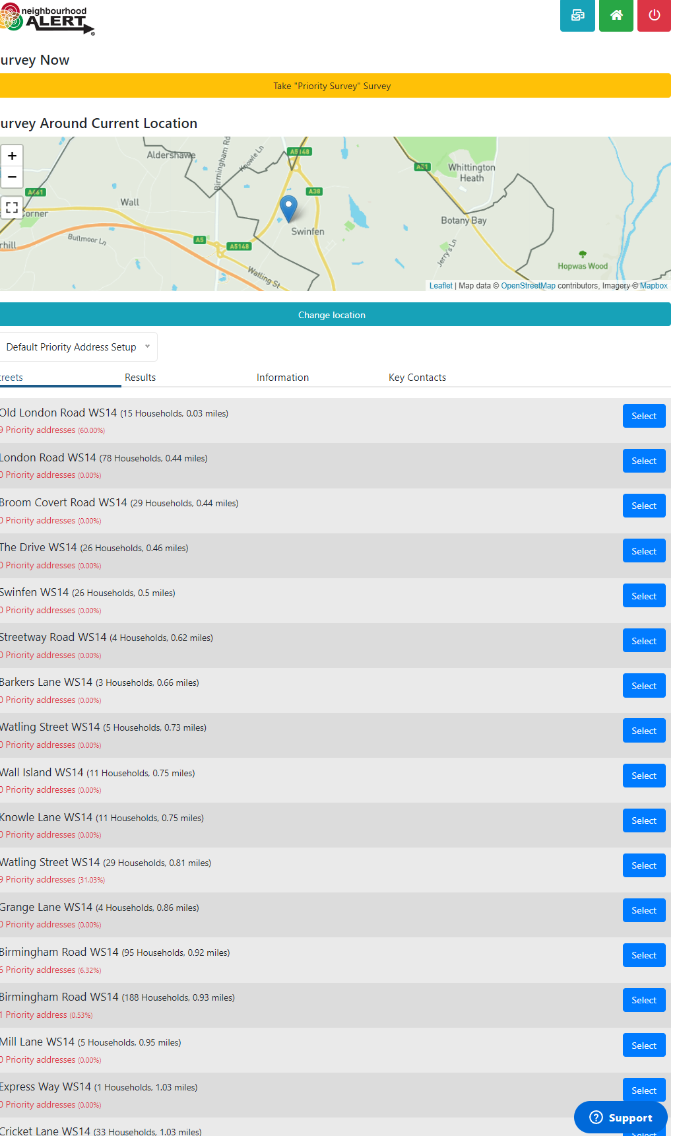
Select a Street
This view lists the nearest streets to your set location (which will update when you interact at an address).
Click on a street that you intend to visit.

Slide 16
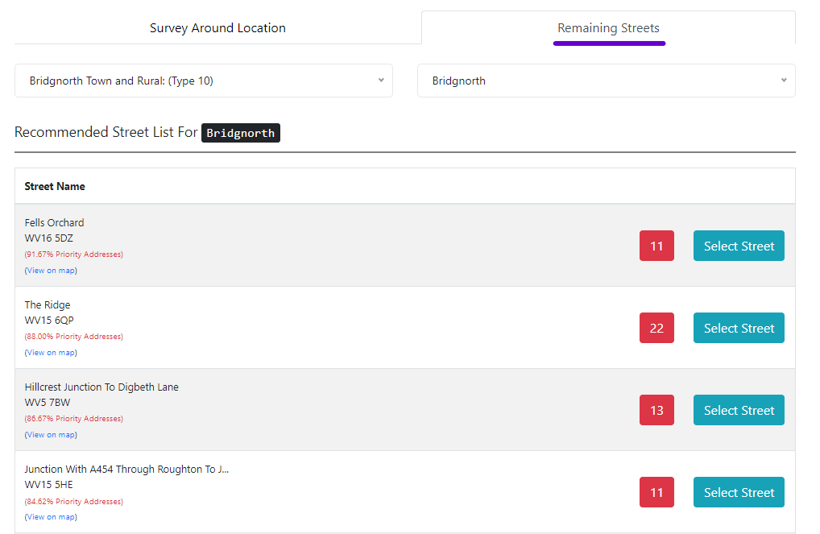
(Remaining Streets)
This view lists the priority addresses remaining that have not been actioned (Surveyed, Sent a survey, etc) in this area.
This is based on the local Priority Setup that you have selected here in rapport.

Slide 17
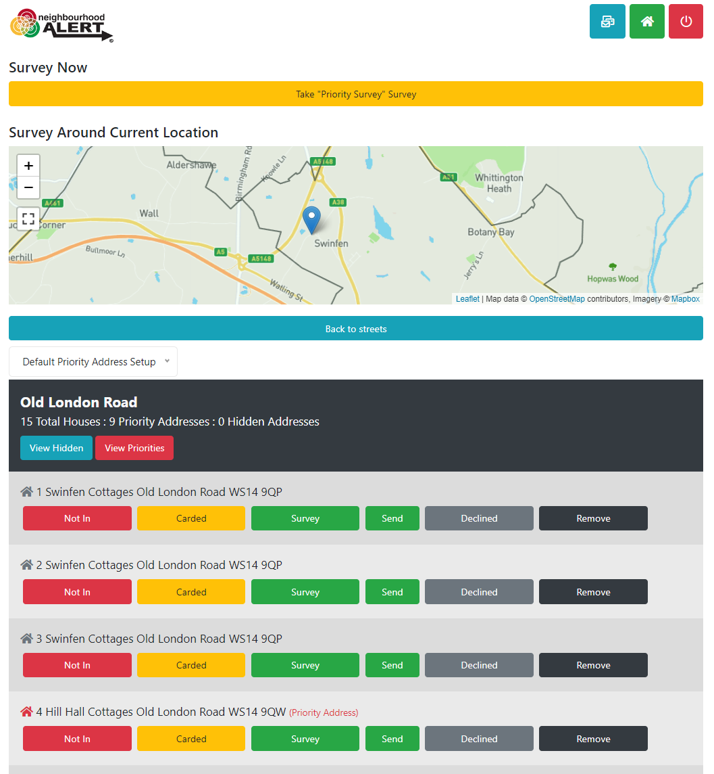
Street View
This view lists the recommended addresses for you to call on.
Existing registered addresses, recently visited and declined addresses are not listed.
A few “priority” addresses may be shown with a red house icon, for various reasons, these are priorities (do not advise the citizen that their address is a priority). You can click the “View Priorities” button to filter the list to just show the priority addresses (if there are any).
Knock on the door and record the interaction using the button options.

Slide 18
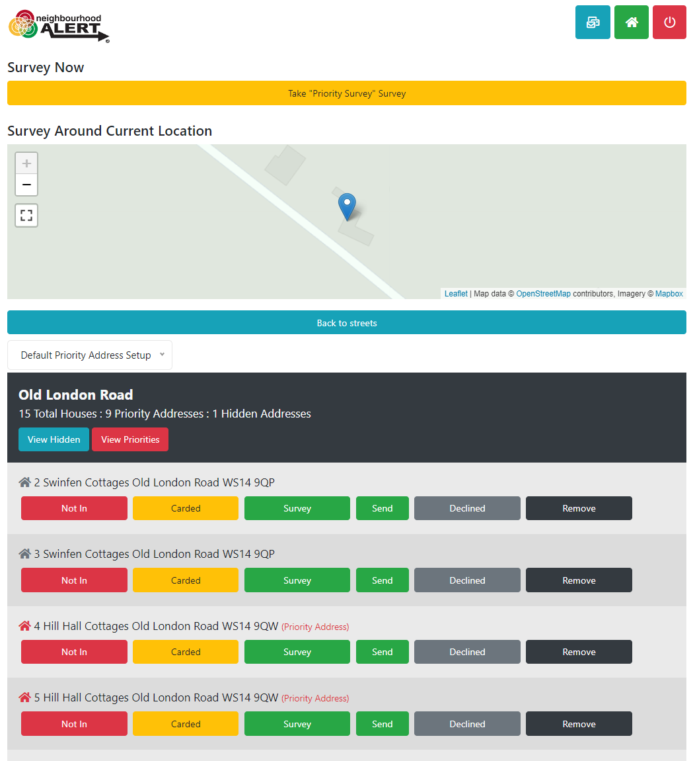
Street View: Interactions
If you click “Not in” the address is removed from everyone's list until 6pm that evening
If you post a card/flyer/collateral through the door, click “Carded” and this address will be removed for a week
Surveyed, Send Survey and Declined households are removed for six months
Remove, takes the address off the database permanently, use this for incorrect, non-household addresses (eg Electrical sub stations, phone boxes etc)

Slide 19
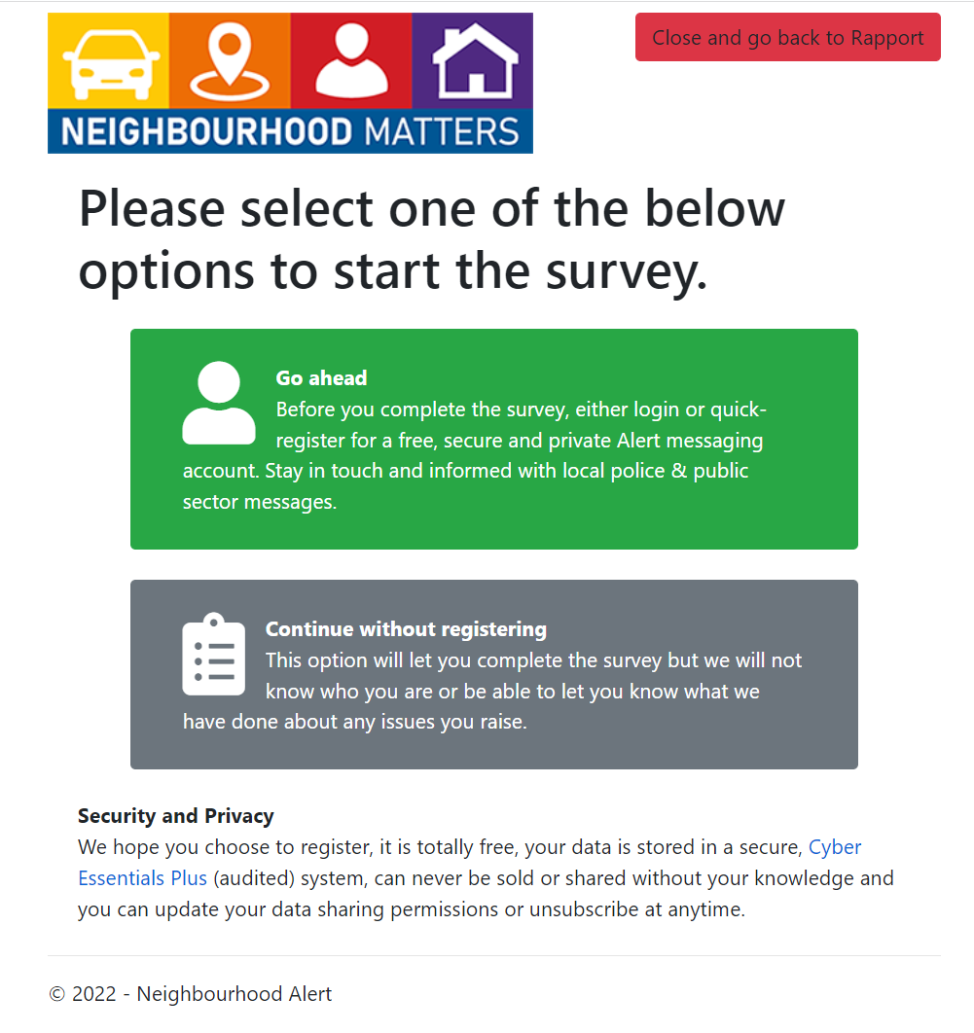
Perform the Survey (Tips)
Do not call it a “Survey”, you are there for a “quick chat/conversation and are trying to find out about the area”
Set the timeframe: eg:“It will only take five minutes, I only have five minutes actually as I have been tasked with doing the whole street!”
Initial try for registration: “Would it be OK if we keep in touch with you afterwards, so we can update you regarding anything you mention today?”
3 key points: It’s free, It’s confidential and you can un-subscribe at any time.
Click either Green or Grey (non-register) Don’t press the point, they have a chance at the end to change their mind.

Slide 20
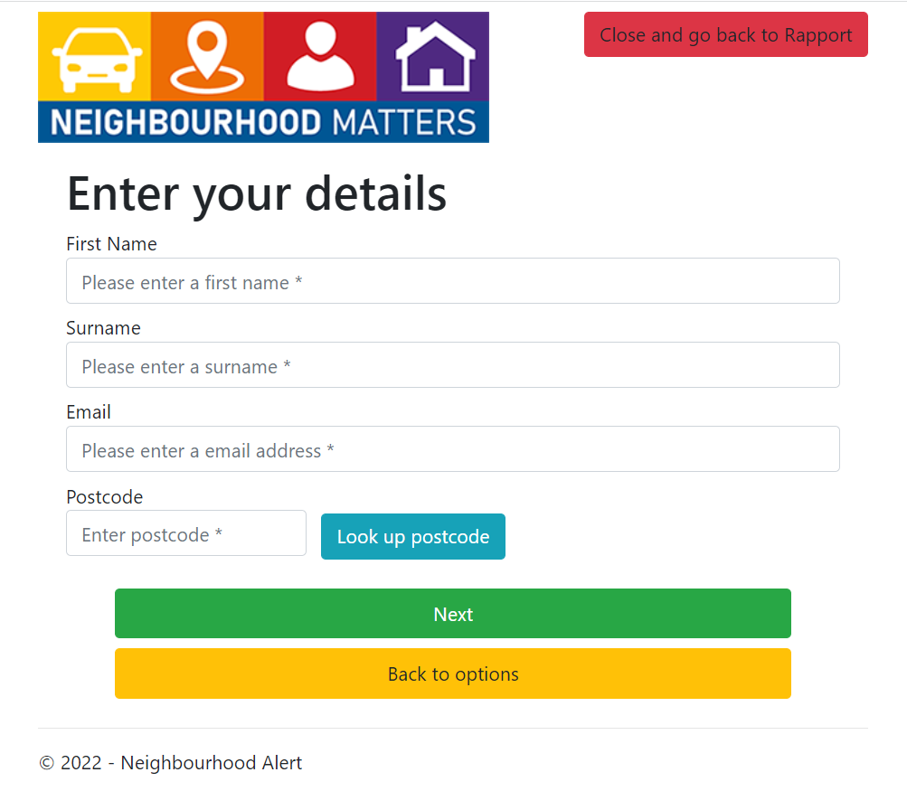
Go Ahead… (registration method)
Fill in the basic details and click “Next”
This will check if they are already registered or not.
If they are registered, it will tell you and send them an email to do the survey in their own time. Ask them to look out for the email and reassure them that the information they provide is important etc.

Slide 21
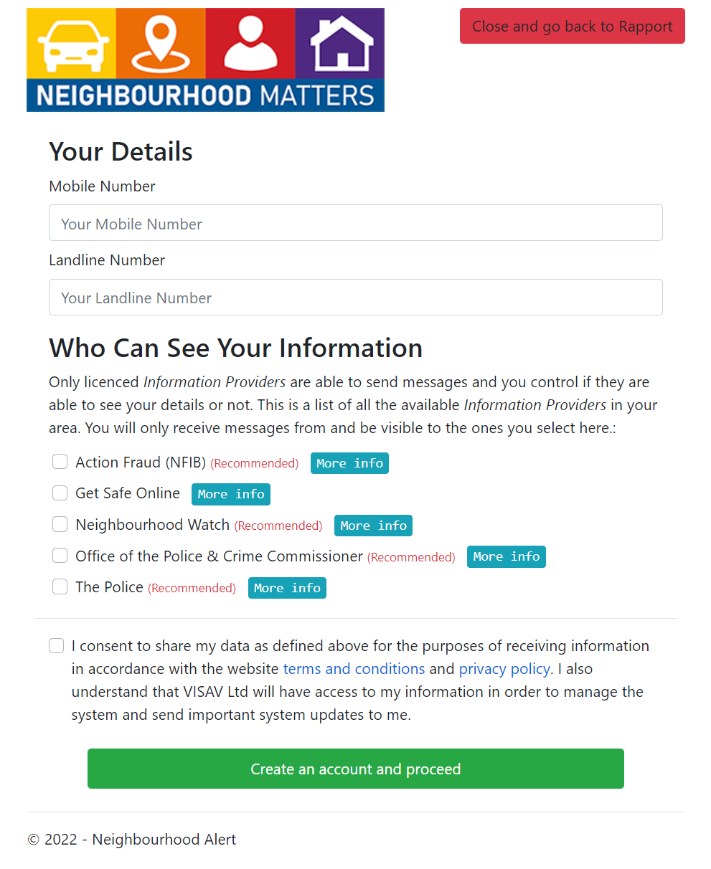
Go Ahead… New Registration
They must have “Police” ticked to receive any service
“Action Fraud” will warn them about scams and fraud attempts
“Neighbourhood Watch” will connect them with the local coordinator and enable trusted volunteers to help keep the database updated.
If the person is not already registered, you will see this screen next.
Ask for a mobile number, explain that this is only used if we need to let them know that their email has stopped working or if something is really urgent.
Ask if they will agree to receive information from “Crime and Safety partners”.
Point out:
  This is NOT marketing information
  No data will ever be sold or shared
  They can turn any partner off at any time from any email
Ask a final time if they agree, tick the box and click create account. (Explain that they will receive an email to confirm)

Slide 22
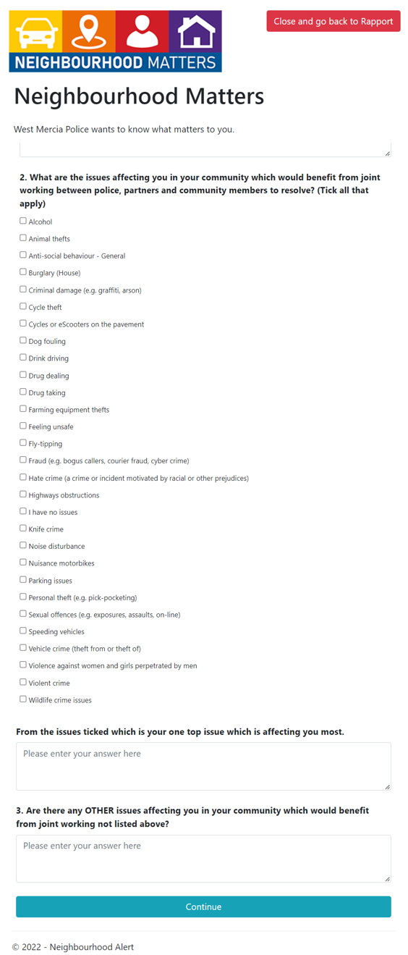
The “Conversation”
Start with “What’s good”, you are not there to solve every problem they can think of, this is a conversation about what they think about the area.
Q1: Just list a few key words, (Eg, shops, Transport, park), not sentences.
Q2: If/when safe to do so, pass the device to them, give them time to consider the choices.
Do NOT influence (“Next door said…”)
Ideally 3-5 options is fine, if they try to tick all/lots, ask which are their priority ones. “Which ones should be addressed first by Police, locals and partners?”
There is an “I have no issues” option
Type one or two words what the top issue is
Record any other issues that may be added to the list in the future.

Slide 23
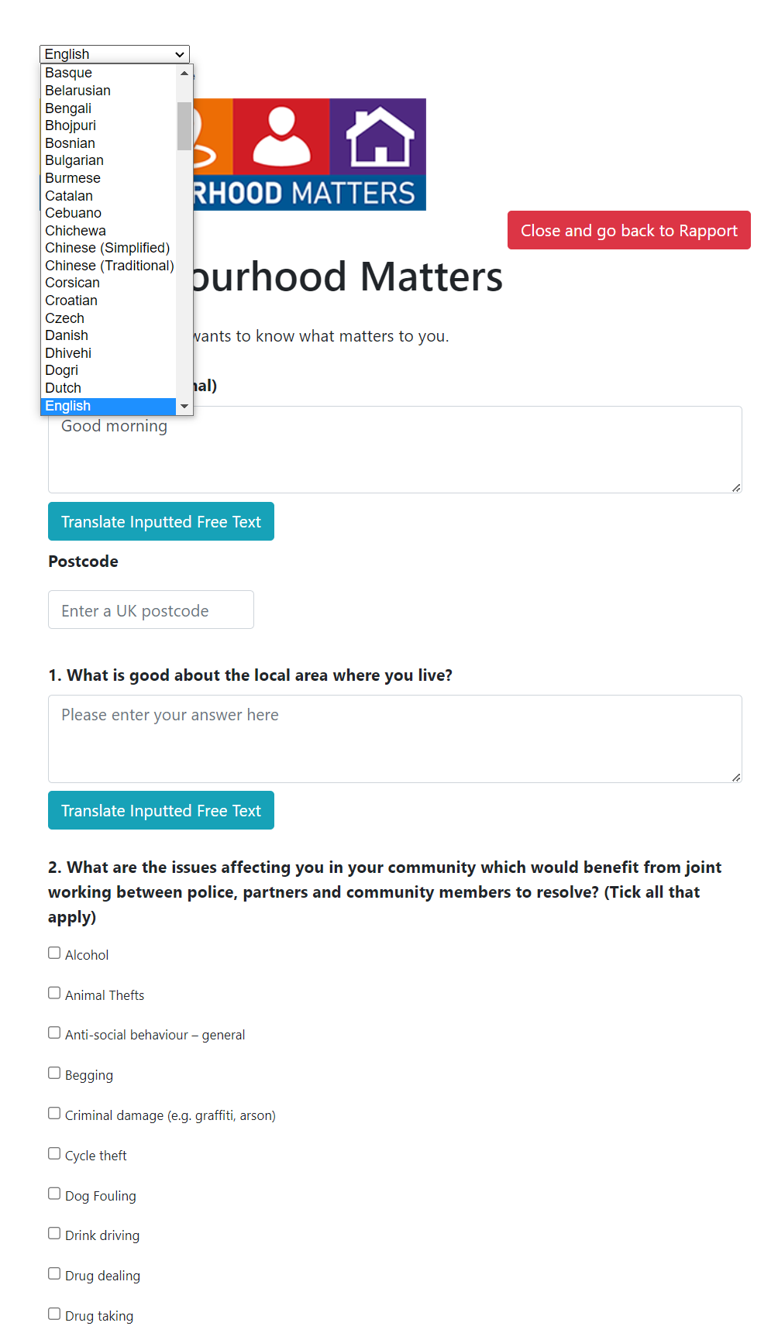
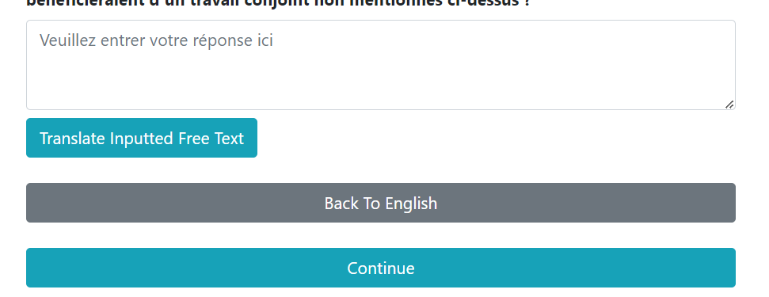
Translation
If someone is struggling with English, use the translate drop down to translate all the questions into any of 100 languages.
If they enter “free text” in non-English, use the “Translate Inputted Free Text” button to translate it back to English before moving on (check that they have understood the question).
Its not perfect! Sometimes the translation is a little off and other times the page needs refreshing.. sorry.
Use the “Back To English” button to transfer back to English at the end of the survey (or anytime)

Slide 24
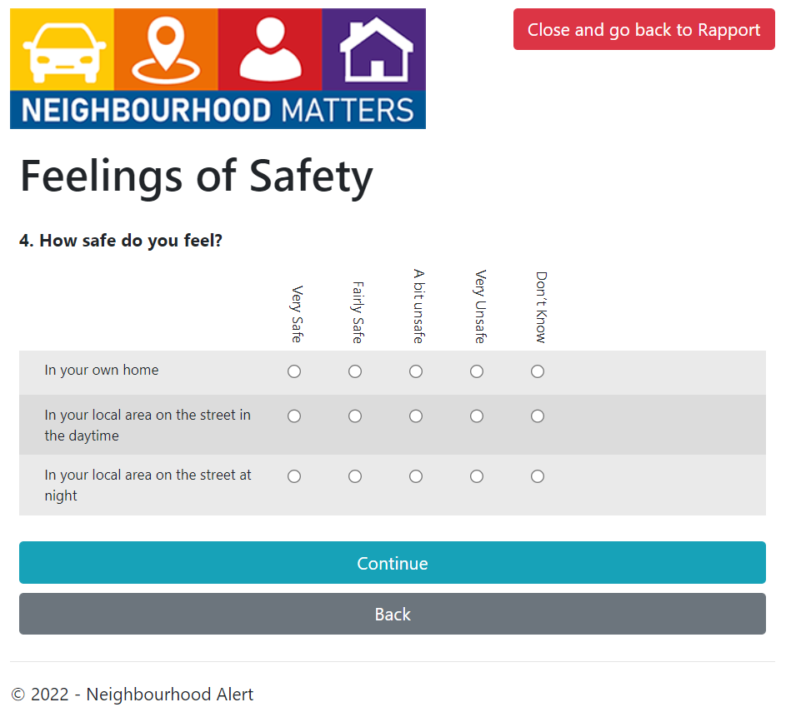
How Safe?
Q4: Questions about feelings can vary a lot, don’t lead
There is a “Don’t know” question response if they are struggling to answer.

Slide 25
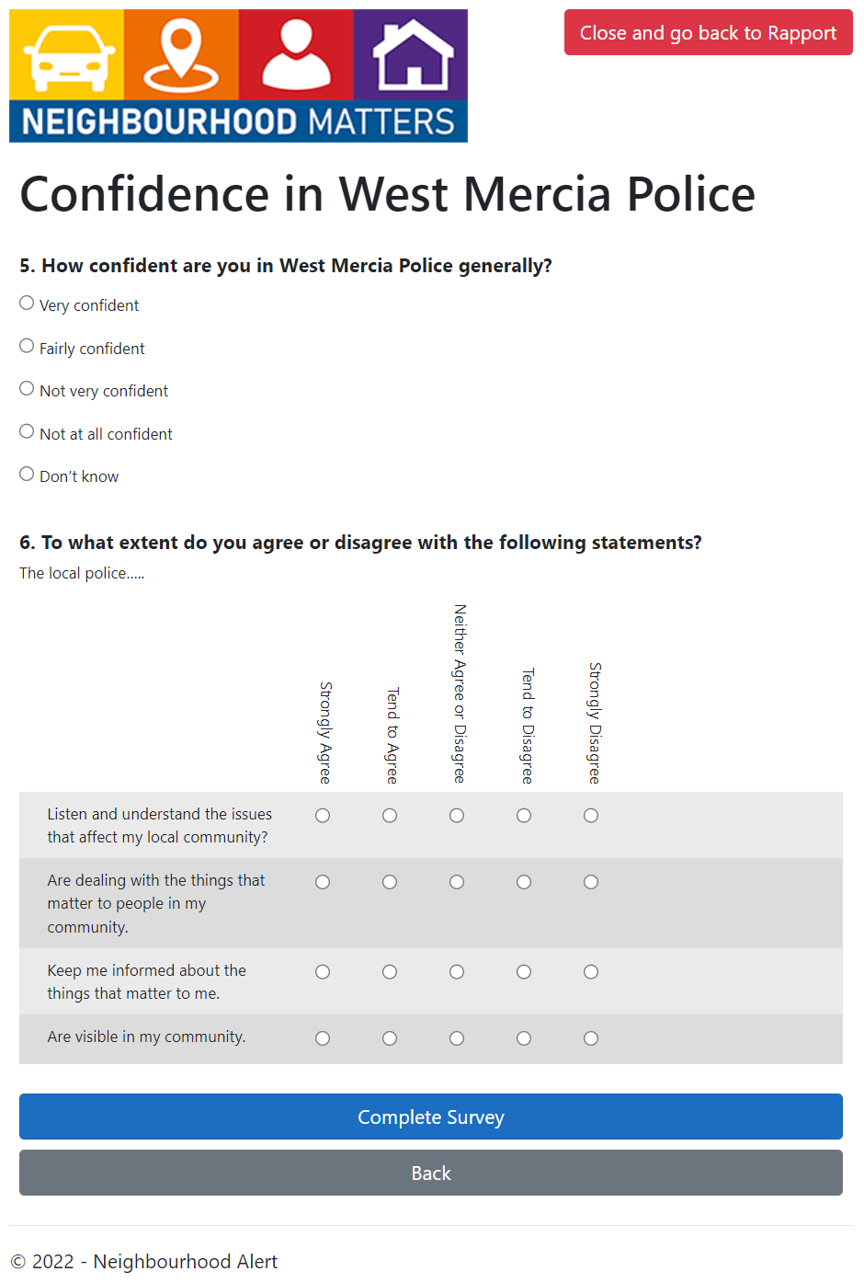
How Good Are We?
Q5: It is important that the person being surveyed does not feel pressured.
Say “just be honest” and give them time to consider their answer. We want the public to feel that you are genuinely interested in their honest opinion.
Half a turn away
What will they think when they reflect on your visit afterwards?

Slide 26
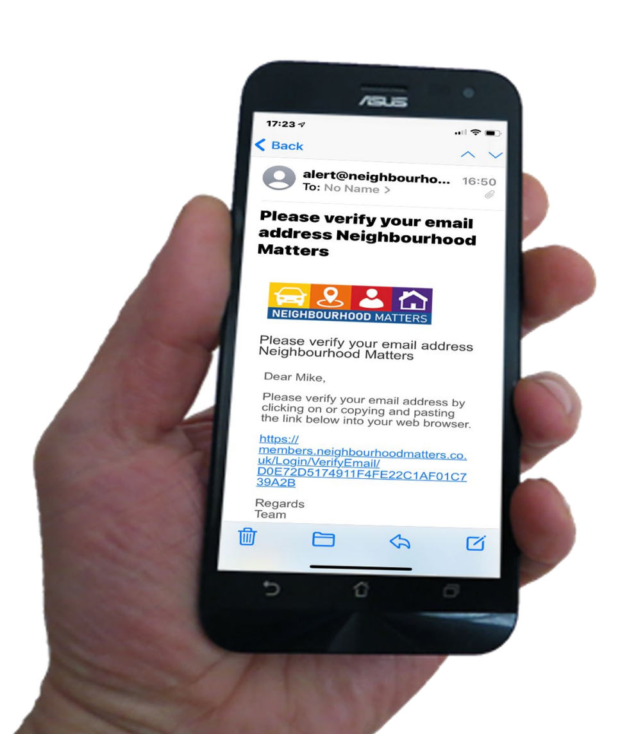
Important: Email Verification
It is vital that they click the link in the email that has been sent to them. Otherwise the registration will be deleted.
Ask: “Do you receive your emails on your mobile? Would you mind checking that you have received one from the Alert system?”
Ask them to click the link. This will take them to a page to set up passwords etc, they can do that later, the important job is done.

Slide 27
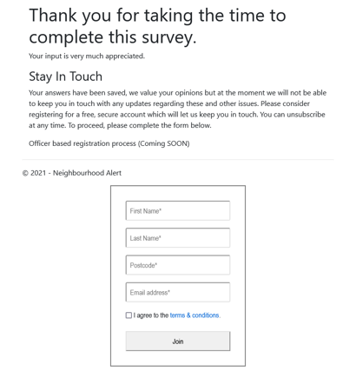
Final Tip: The second Chance
40% of those that said no the first time will register when asked again at the end!
If people have done the survey “Without registering”, at the end of the survey they have another chance to register.
This will save their answers and mean they can receive updates about the issues raised.
Don’t be afraid to ask again “You have raised some good points, It would be really helpful if we could keep in touch, could I add you to our Sussex Alerts communication system?”
It’s free, its safe and you can come off anytime if its not for you.

Slide 28


Where To Find Help
email: Support@neighbourhoodalert.co.uk
Teams support: www.calendly.com/visavsupport
Tel: 0115 9245517 (option 1) Mon-Fri 9am-5pm
Training Link: https://www.neighbourhoodalert.co.uk/v4training
Live Chat: Use the live chat button in Rapport
Help Centre: https://visavltd.zendesk.com/hc/en-gb
(or google “VISAV Help Centre”)
Rapport: Visit the help & Settings” section for videos, internal contacts and more

