Slide 1
Delivering the Community Link Priority Survey
Key requirements to find and deliver the Neighbourhood Alert, Enhanced Module, Priority Survey
Mar 2023

Slide 2
Why Bother?
Seen all this before? What’s the legacy?
Public confidence, so what? (what are the benefits for you?)
More intel to catch criminals
Drive engagement: Action when you need it
Connect with local contacts
Drive Neighbourhood Watch Activity: Active Citizens

Slide 3
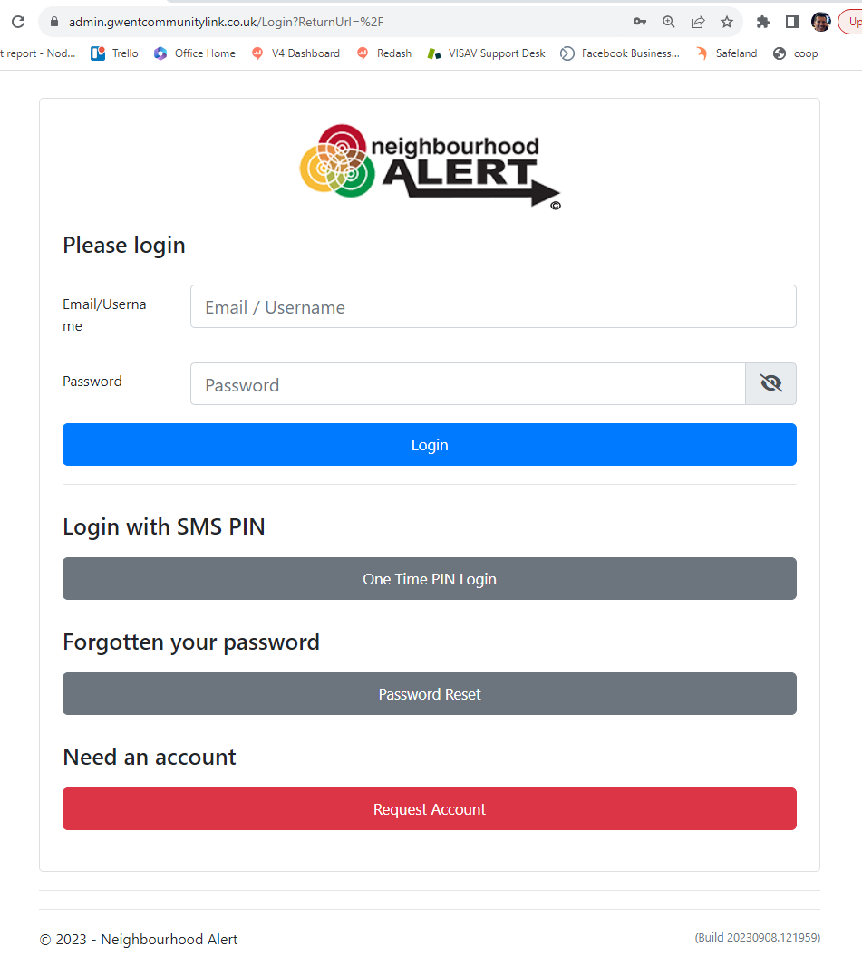
1) Ensure you have access to “Rapport”
Rapport is the secure admin area used to access the Neighbourhood Alert database from a mobile device
You will need to request an admin account (if you don’t already have one), by going to: https://admin.gwentcommunitylink.co.uk
Click the red ”Request Account” button

Slide 4
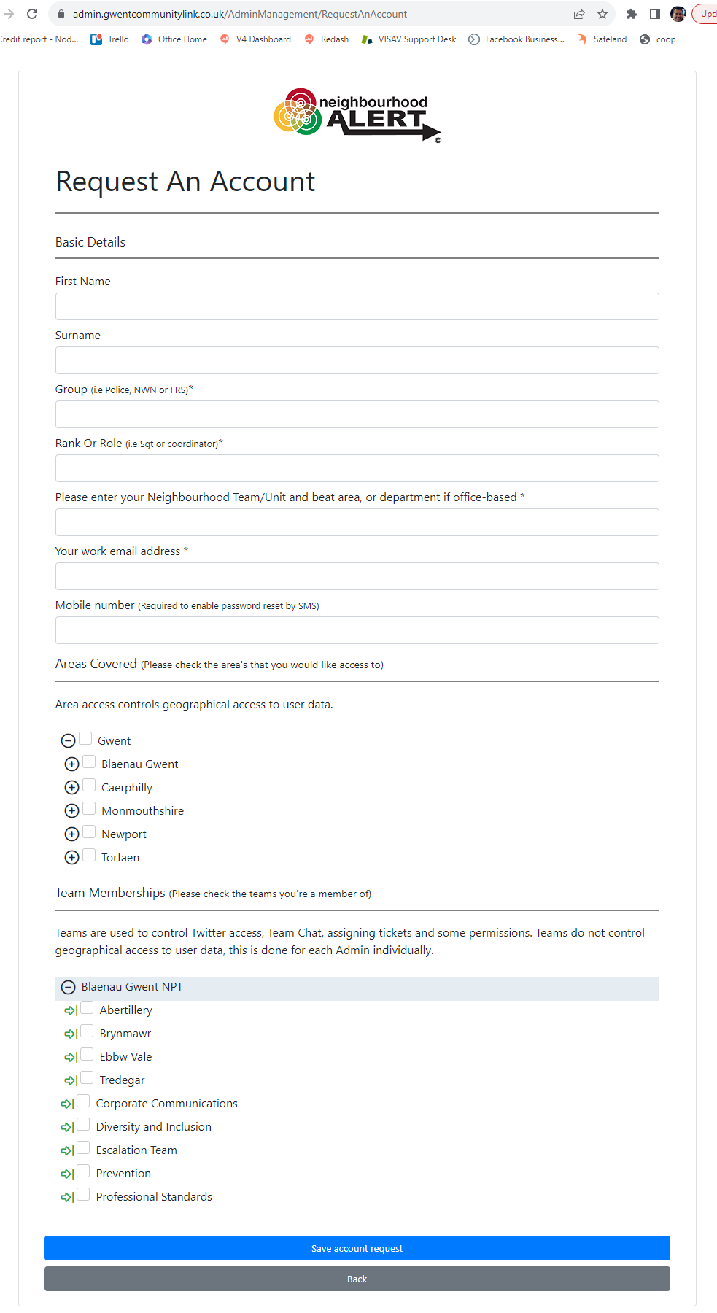
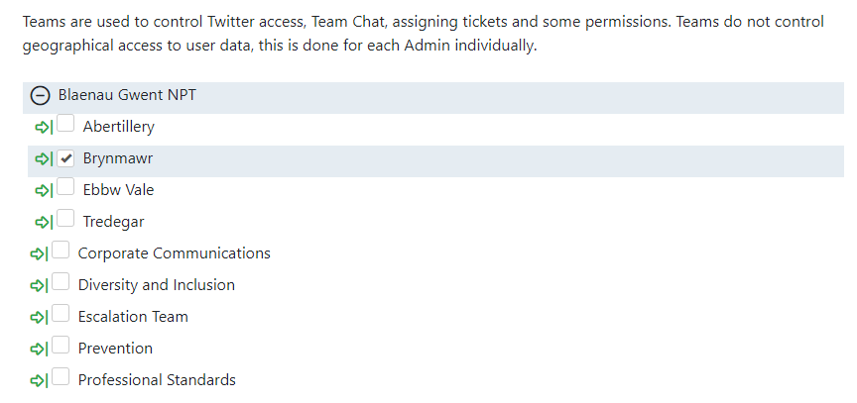
Request an account
Complete the form with your details (no shared email addresses etc)
In “Areas Covered” drill the options down using the + symbols and tick the areas you cover.
Under “Team memberships” tick the Team/Department you work in or drill down the SNTs and select each bottom level area you usually cover.

Slide 5
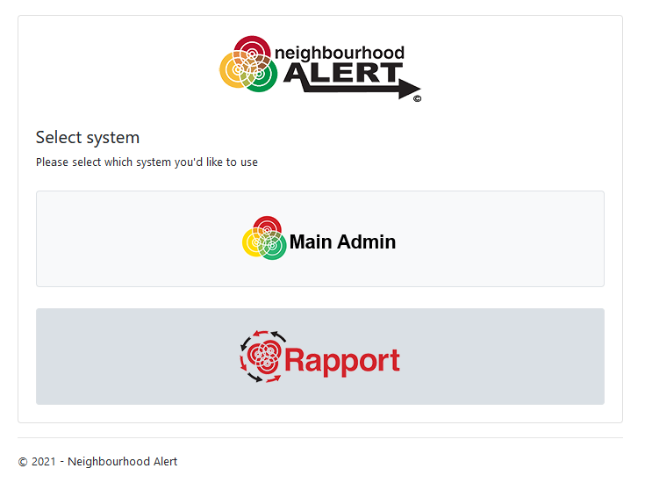
Select Rapport
Once your application is approved, follow the link in the email confirmation and set up your own memorable words and password.
Find the Admin site by going to: https://admin.gwentcommunitylink.co.uk
Click on the “Rapport” button

Slide 6
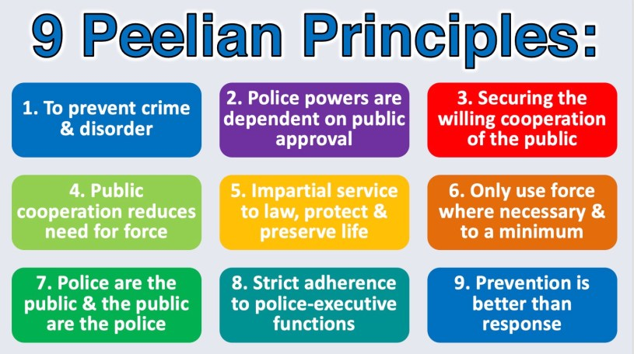
Aims
Make YOUR time count
Give you data in the field
Make every contact with the public count
Start a long-term (low admin) relationship with the public
Inspire confidence, based on 200 year old Peelian principles of UK policing
Drive active citizenship

Slide 7
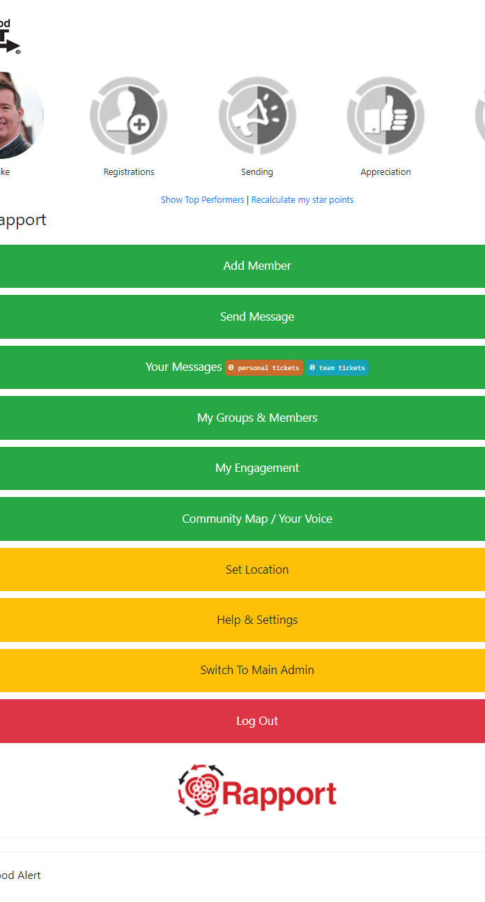
Tasks #1
Log in to Rapport (get to this screen)
Find the Help Centre
Update your profile picture
Set an easy alternative login name

Slide 8
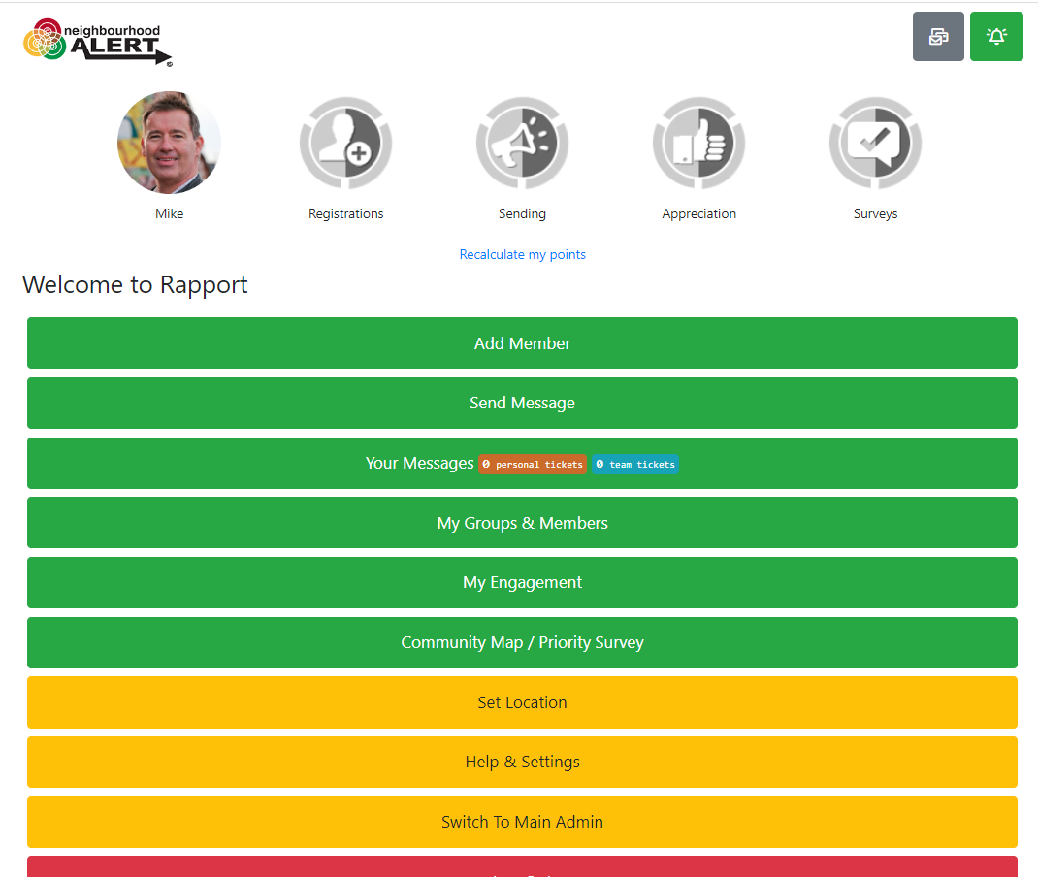
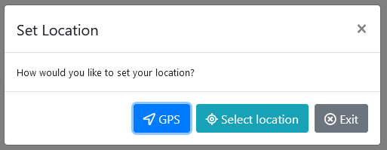
Set Location
On the mobile device you are going to use, click the “Set Location” button
If you are on site, use GPS, otherwise, click the “Select location” option

Slide 9
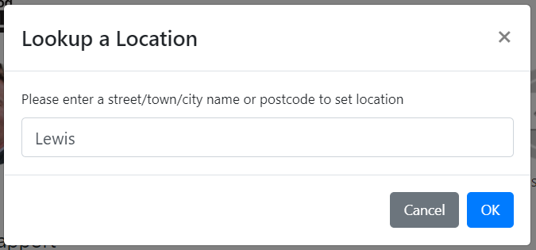
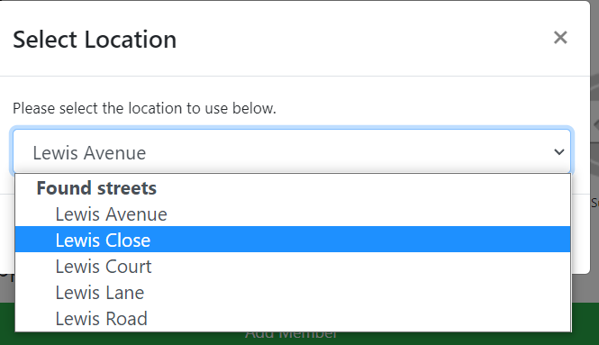
Set location
Type the location to search and click OK
The local Ward area or street should appear, click OK
Confirm with OK on the map view

Slide 10
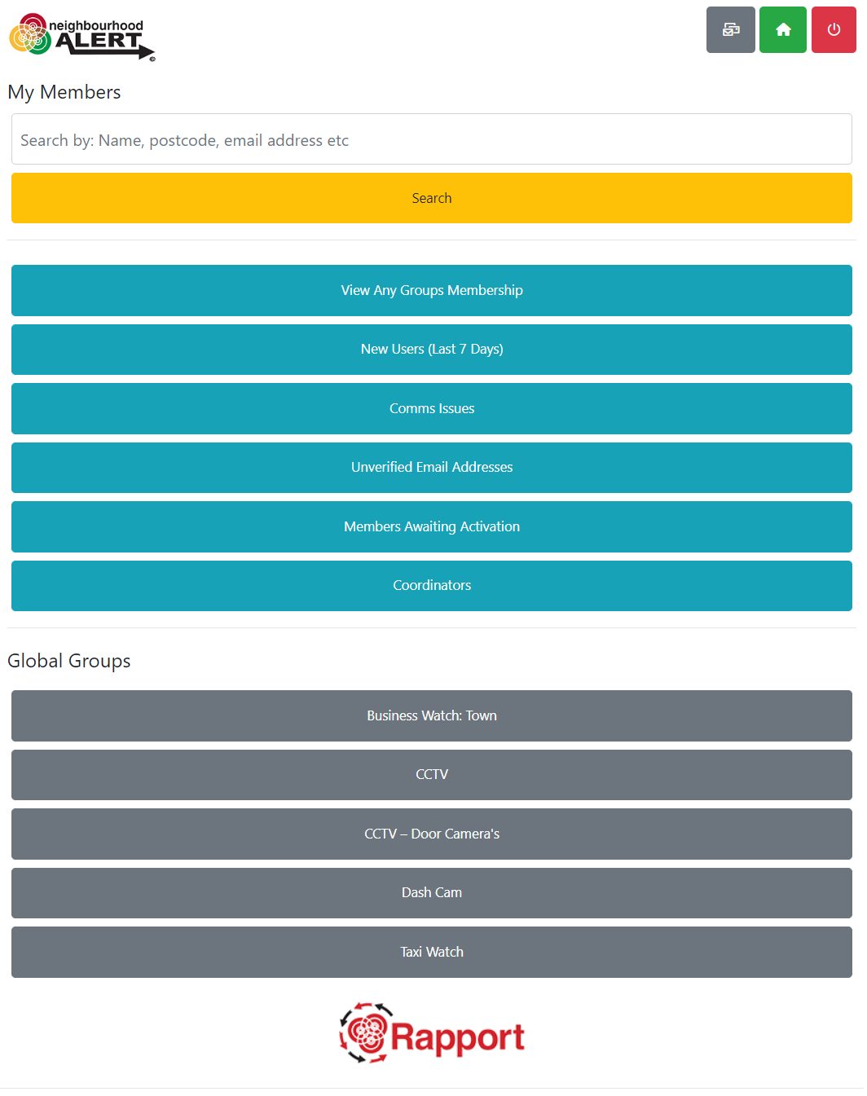
Your members
Browse around the various pre-determined selections.
Note:
Comms Issues is anyone with a comms issue on their account, could be email, SMS or voice
Unverified Email is anyone on the system that has an email that isn’t verified, doesn’t include awaiting activation. Can still receive messages by SMS or voice
Members Awaiting Activation is a user added by either a coordinator or an admin. Won’t receive any messages until activated
Global Groups: People are added to these groups in various ways:
On registration
Completing a survey (with a group question)
By you updating the groups they are in
By them updating the groups they are in from their member admin (some groups are hidden so they cannot add themselves to them e.g., Medical Doctor)

Slide 11
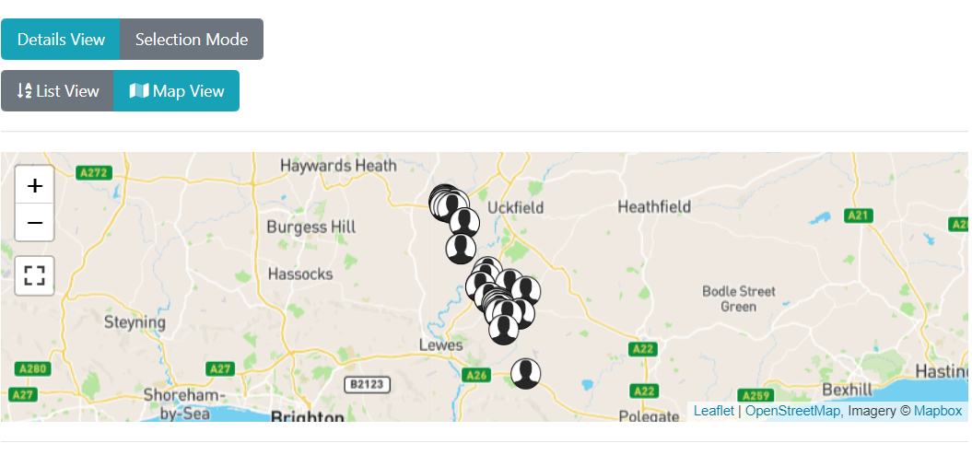
Find the current members
Click on “My Groups and members”
Click “View Any Groups Memberships”
Drill down to a specific area using the small black +
Observe the total number of people in each area and select them by clicking on the black button(s)
Turn the selected area green and click the “Next” button
Scroll all the way down the filter options and click the blue “View list of people” button at the bottom
The next screen shows a small map and lists the nearest 500 people to your set location. Click the “Map view” button
Use the Full screen icon to see a larger map and drag this around to see the current coverage of registered users.

Slide 12
Tasks #2 (Suspended until October 2023)
Find the guidance on sending a message
Add yourself as an end user
Send a message

Slide 13
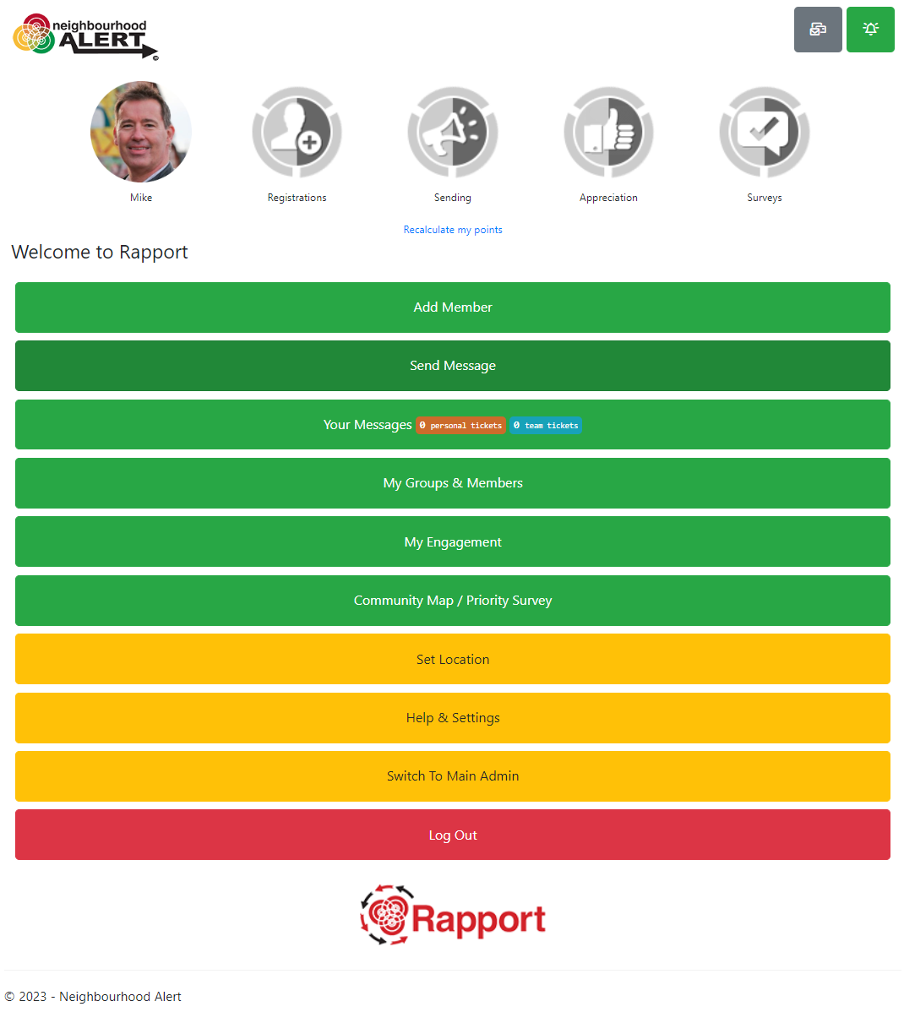
Send A Message

Slide 14
Info At Your Fingertips
Street Lists (Default and Priority ones)
Survey Results
Demographic information
Key Contact lists

Slide 15
Find Addresses and deliver the survey
On the Home screen (accessed with the icon in the top right of the screen), click on the button that shows your priority survey

Slide 16
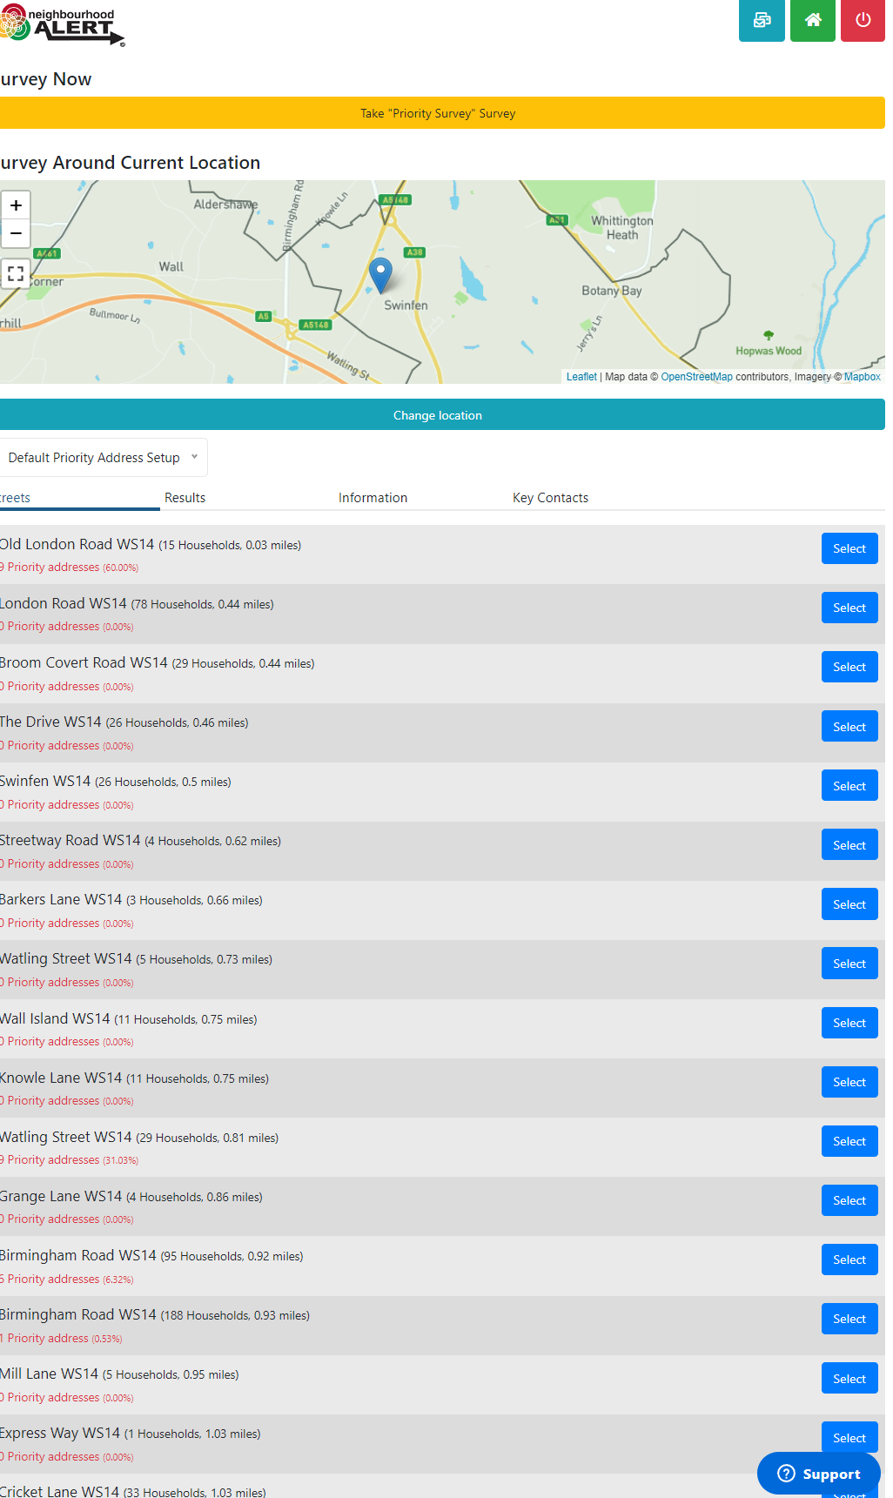
Select a Street
This view lists the nearest streets to your set location (which will update when you interact at an address).
Click on a street that you intend to visit.

Slide 17
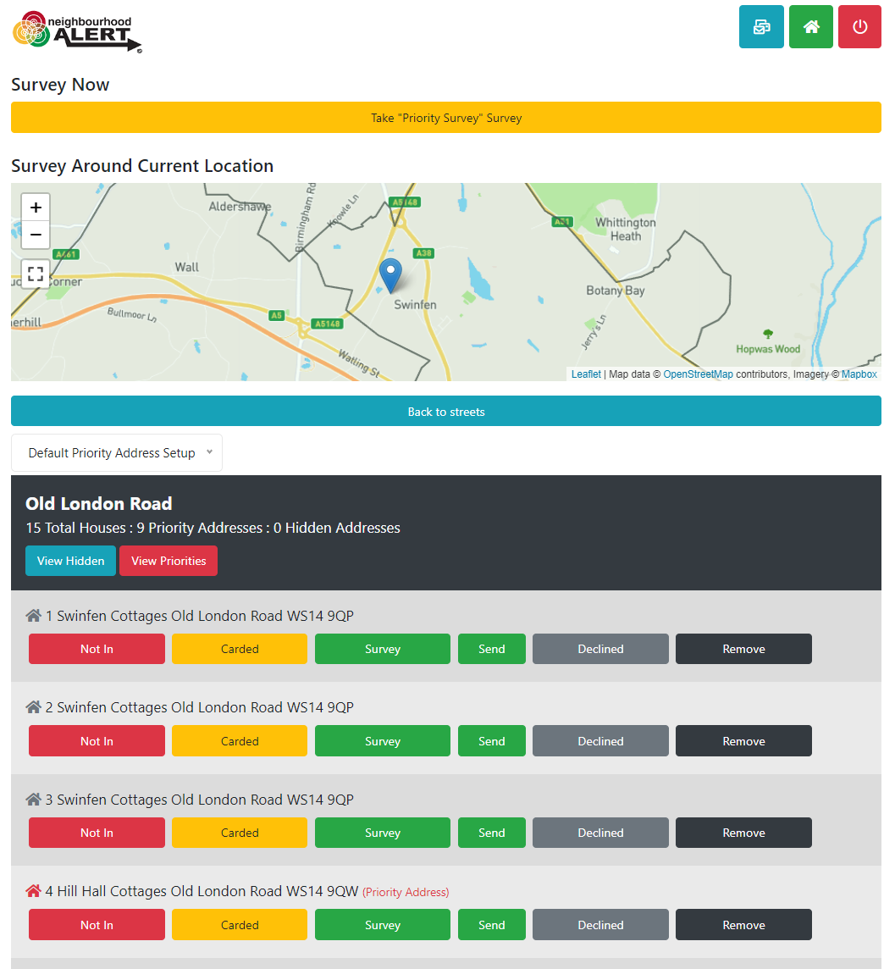
Street View
This view lists the recommended addresses for you to call on.
Existing registered addresses, recently visited and declined addresses are not listed.
A few “priority” addresses may be shown with a red house icon, for various reasons, these are priorities (do not advise the citizen that their address is a priority). You can click the “View Priorities” button to filter the list to just show the priority addresses (if there are any).
Knock on the door and record the interaction using the button options.

Slide 18
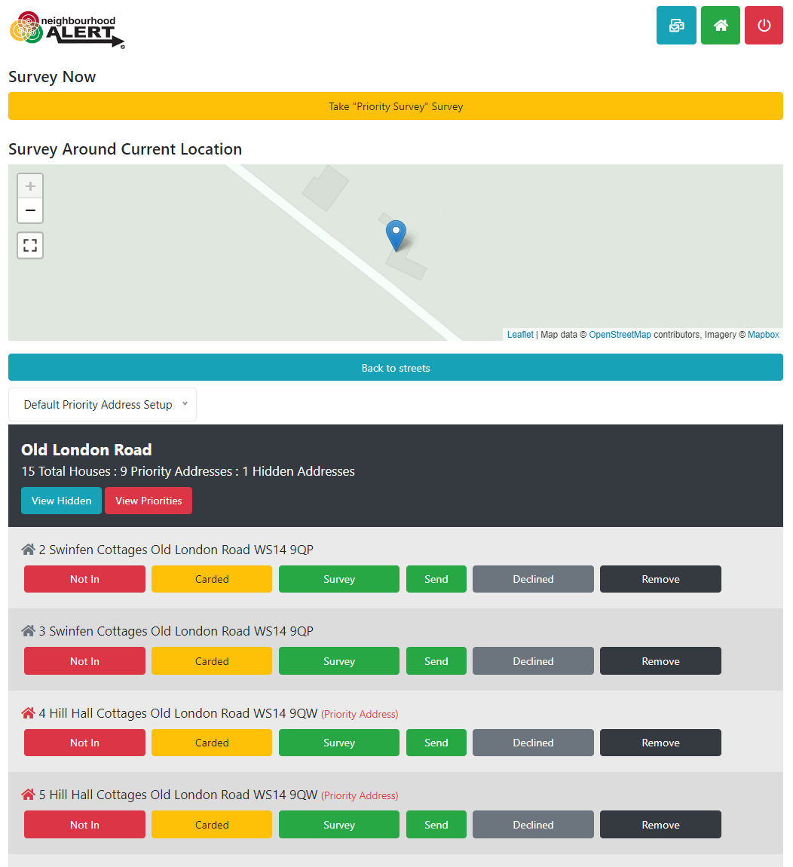
Street View: Interactions
If you click “Not in” the address is removed from everyone's list until 6pm that evening
If you post a card/flyer/collateral through the door, click “Carded” and this address will be removed for a week
Surveyed, Send Survey and Declined households are removed for six months
Remove, takes the address off the database permanently, use this for incorrect, non-household addresses (eg Electrical sub stations, phone boxes etc)

Slide 19
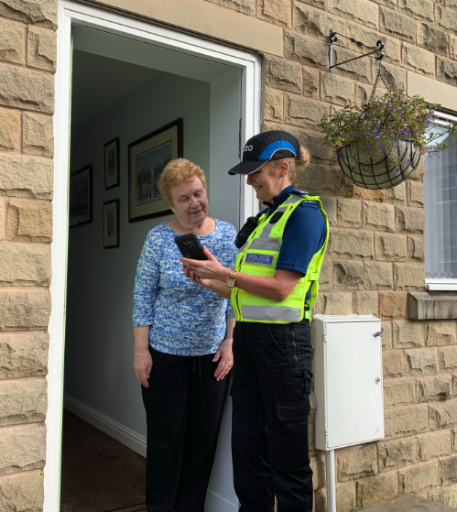
Considerations
It’s all about the impression you make by the time they close the door
This is the start of a long-term relationship (hopefully and if done well)
It’s an opportunity to present the policing experience differently: make it count
Ask yourself what could have been done better after each interaction
Smile

Slide 20
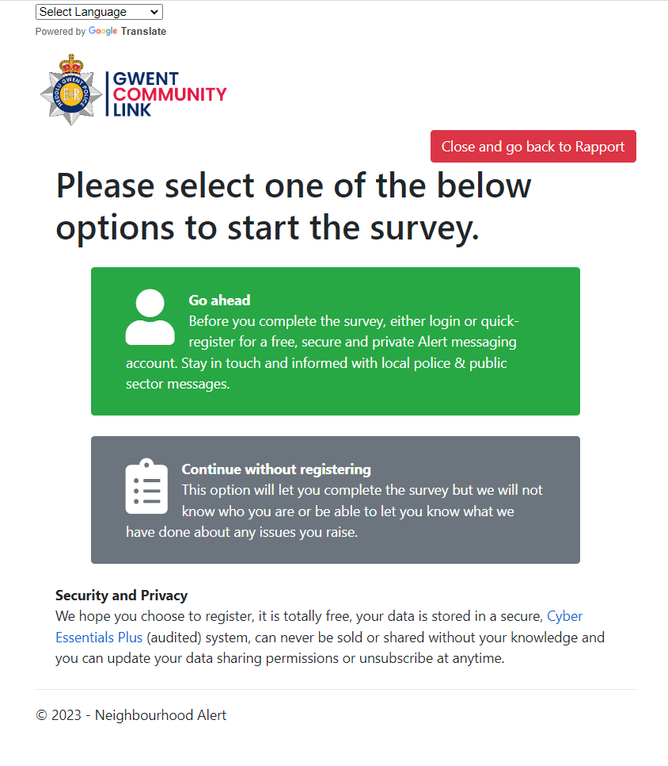
Perform the Survey (Tips)
Do not call it a “Survey”, you are there for a “quick chat/conversation and are trying to find out about the area”
Set the timeframe: e.g. “It will only take five minutes; I only have five minutes actually as I have been tasked with doing the whole street!”
Initial try for registration: “Would it be OK if we keep in touch with you afterwards, so we can update you regarding anything you mention today?”
3 key points: It’s free, It’s confidential and you can un-subscribe at any time.
Click either Green or Grey (non-register) Don’t push too hard, they have a chance at the end to change their mind.

Slide 21
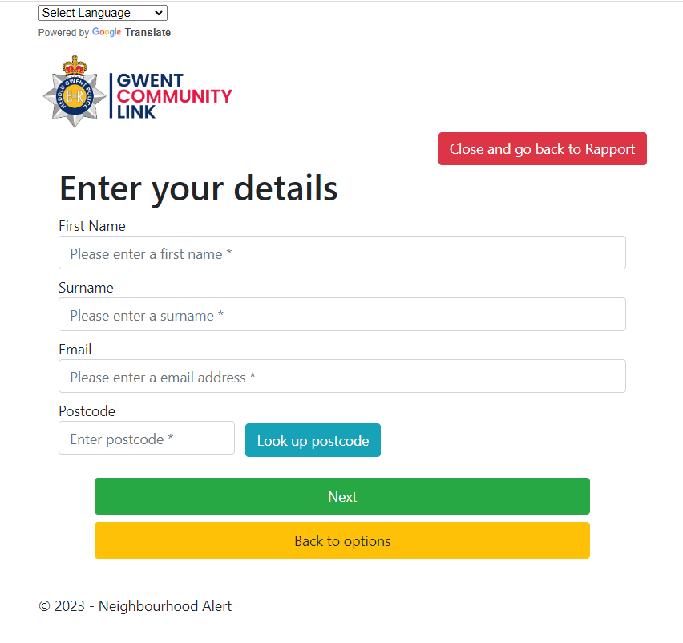
Go Ahead… (registration method)
Fill in the basic details and click “Next”
This will check if they are already registered or not.
If they are registered, it will tell you and send them an email to do the survey in their own time. Ask them to look out for the email and reassure them that the information they provide is important etc.

Slide 22
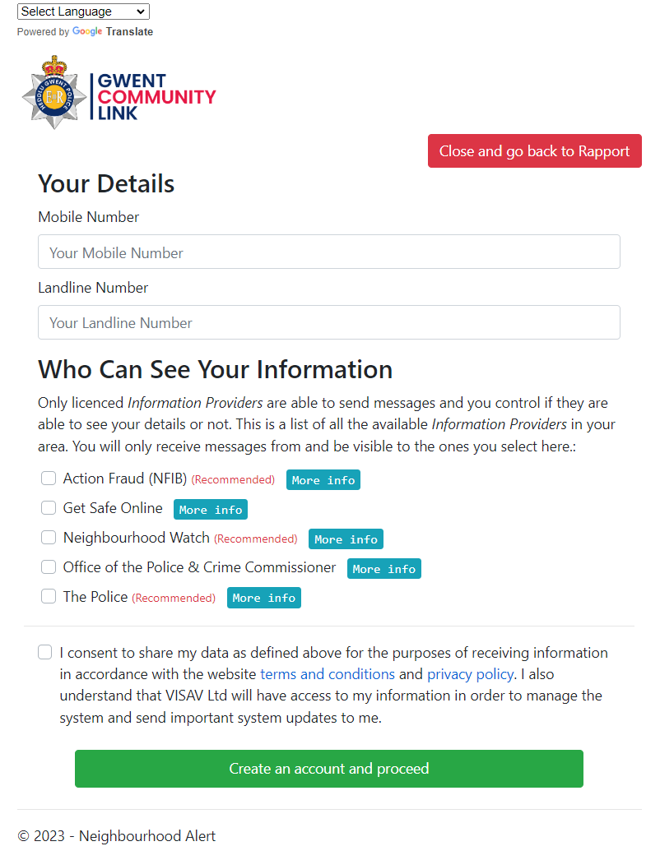
Go Ahead… New Registration
They must have “Police” ticked to receive any service
“Action Fraud” will warn them about scams and fraud attempts
“Neighbourhood Watch” will connect them with the local coordinator and enable trusted volunteers to help keep the database updated.
If the person is not already registered, you will see this screen next.
Ask for a mobile number, explain that this is only used if we need to let them know that their email has stopped working or if something is urgent.
Ask if they will agree to receive information from “Crime and Safety partners”.
Point out:
This is NOT marketing information
No data will ever be sold or shared
They can turn any partner off at any time from any email
Ask a final time if they agree, tick the box and click create account. (Explain that they will receive an email to confirm)

Slide 23
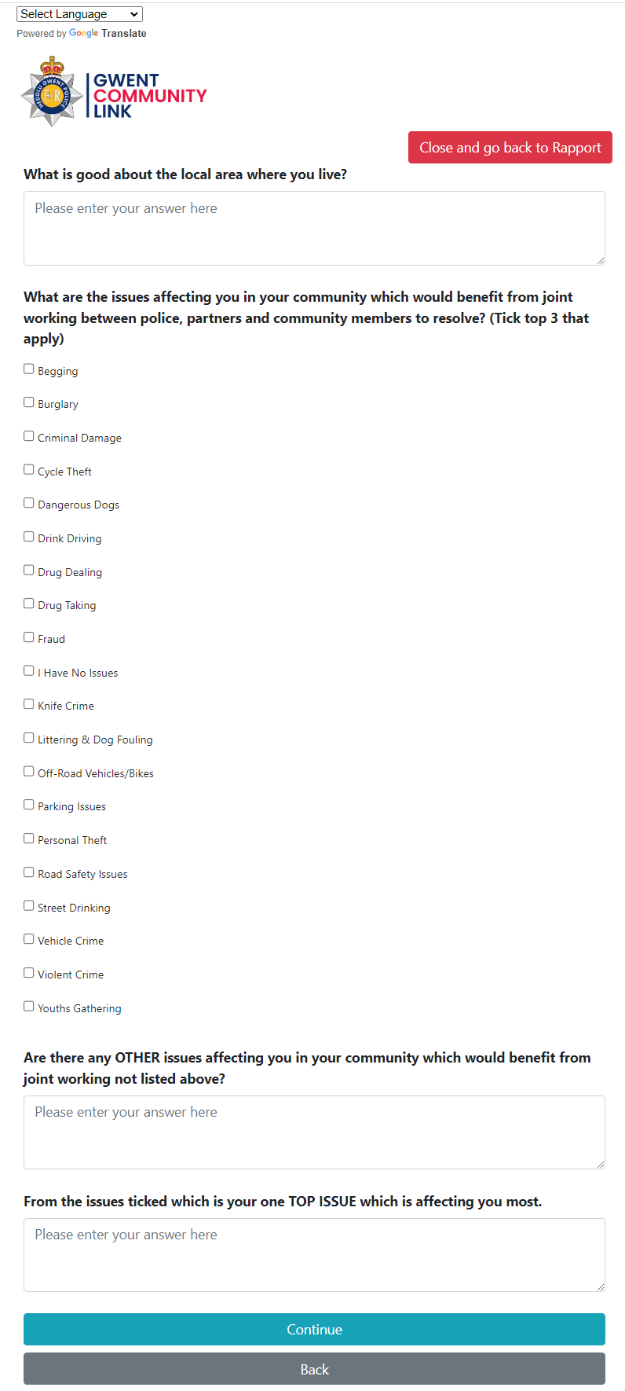
The “Conversation”
Start with “What’s good”, you are not there to solve every problem they can think of, this is a conversation about what they think about the area.
Q1: Just list a few key words, (E.g. shops, Transport, park), not sentences.
Q2: If/when safe to do so, pass the device to them, give them time to consider the choices.
Do NOT influence (“Next door said…”)
Ideally 3 options maximum, if they try to tick all/lots, ask which are their priority ones. “Which ones should be addressed first by Police, locals and partners?”
There is an “I have no issues” option
Record any other issues that may be added to the list in the future.
Type one or two words what the top issue is

Slide 24
Translation
If someone is struggling with language, use the translate drop down to translate all the questions into any of 100 languages.
If they enter “free text” in non-English, use the “Translate Inputted Free Text” button to translate it back to English before moving on (check that they have understood the question).
It’s not perfect! Sometimes the translation is a little off and other times the page needs refreshing.. sorry.
Use the “Back To English” button to transfer back to English at the end of the survey (or anytime)

Slide 25
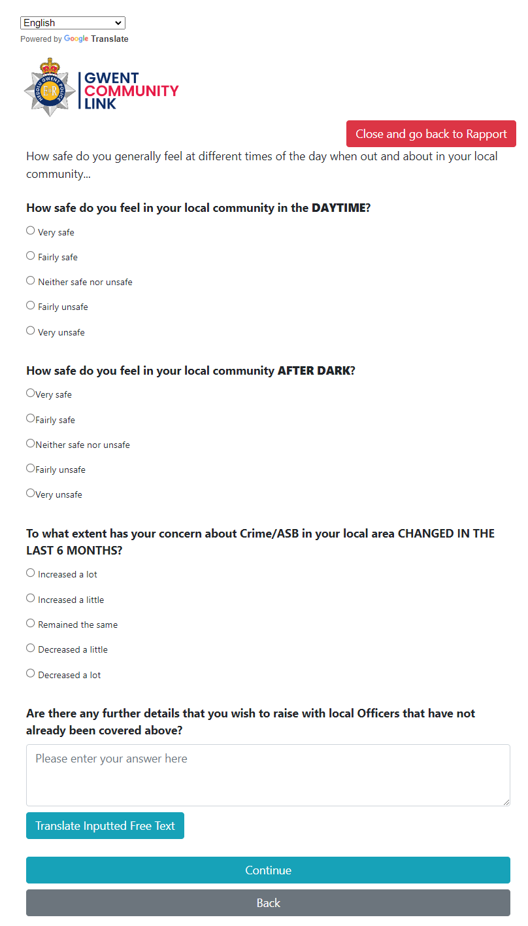
How Safe?
Questions about feelings can vary a lot, don’t lead
All questions can be “skipped” if they are struggling to answer.
If at any time issues are raised that are crimes or matters of real concern, ditch the survey and revert to policing practice.

Slide 26
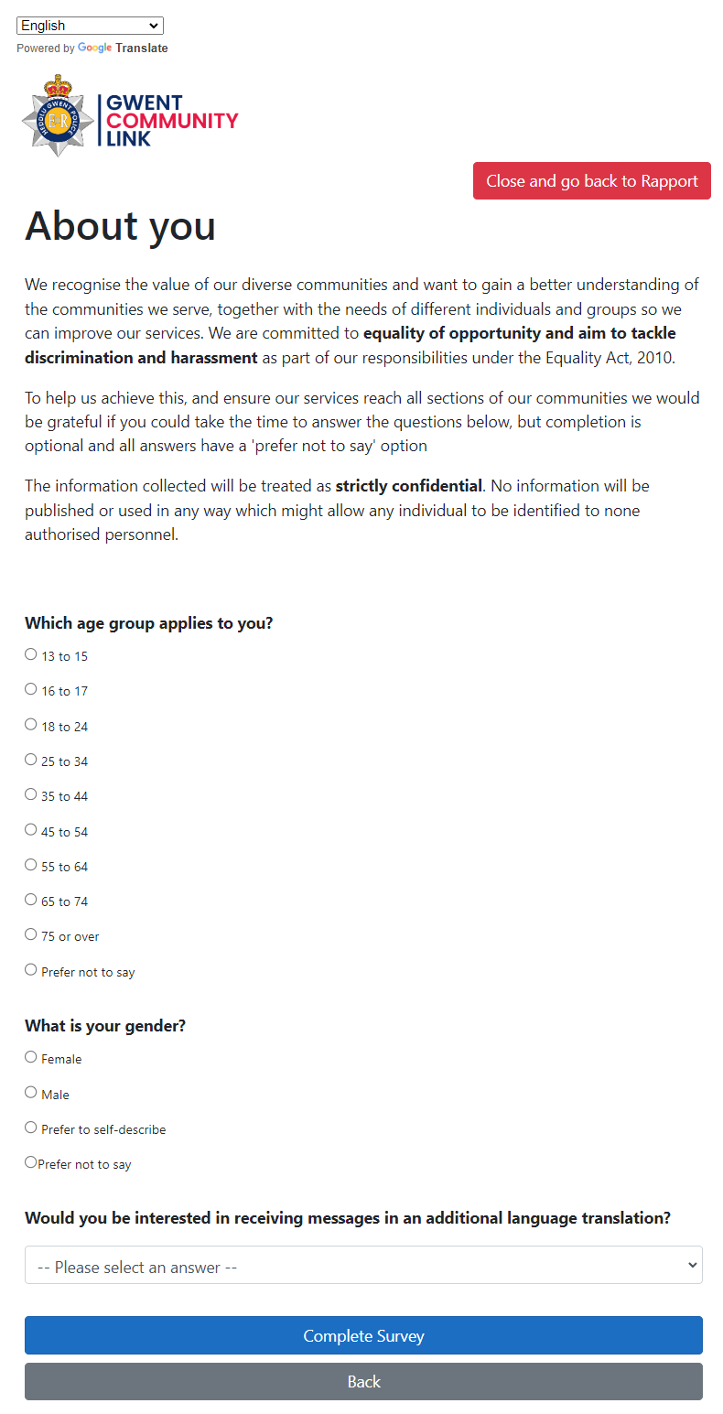
Demographic Data
Let them fill this in if it is safe to (and they can see it)
It is to help to ensure that everyone gets a voice on Gwent Community Link (no groups are excluded)
We will send a private survey out in a week or so to ask a bit more about you so messages can be relevant.

Slide 27
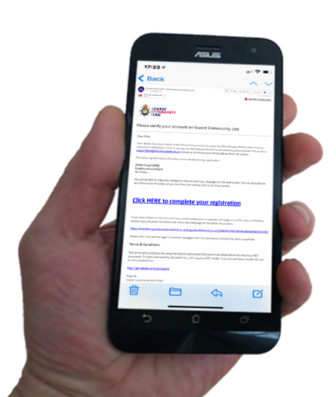
Important: Email Verification
It is vital that they click the link in the email that has been sent to them. Otherwise the registration will be deleted.
Ask: “Do you receive your emails on your mobile? Would you mind checking that you have received one from this Alert system?”
Ask them to click the link. This will take them to a page to set up passwords etc, they can do that later, the important job is done.

Slide 28
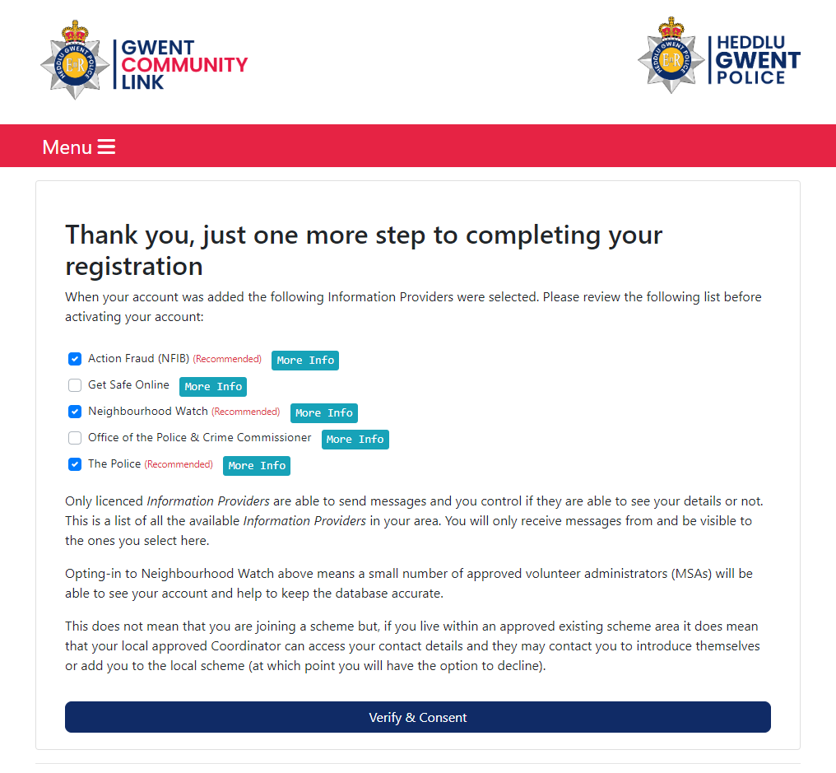
Verify & Consent
After clicking the link they see this screen and can make changes.
They need to click the bottom button to give consent to set up their account and receive future messages.
They can make any changes at any time in the future.

Slide 29
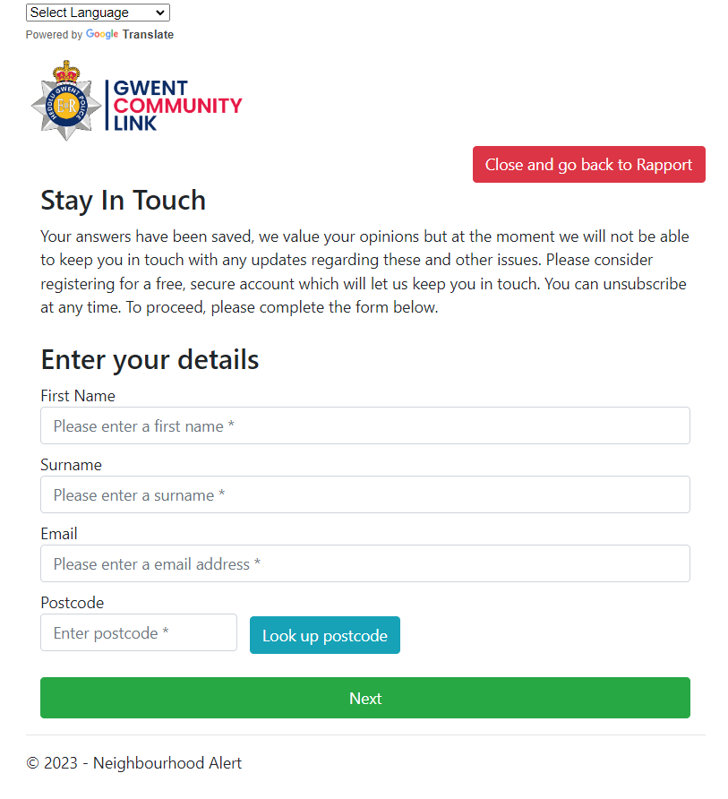
Final Tip: The second Chance
40% of those that said no the first time will register when asked again at the end!
If people have done the survey “Without registering”, at the end of the survey they have another chance to register.
This will save their answers and mean they can receive updates about the issues they raised.
Don’t be afraid to ask again “You have raised some good points, It would be really helpful if we could keep in touch, could I add you to our Community Link system?”
It’s free, its private, no one else knows you have joined (it’s not social media) and you can delete your account anytime if it’s not for you.

Slide 30
Where To Find Help
email: Support@neighbourhoodalert.co.uk
Teams support: www.calendly.com/visavsupport
Tel: 0115 9245517 (option 1) Mon-Fri 9am-5pm
Training Link: https://www.neighbourhoodalert.co.uk/v4training
Live Chat: Use the live chat button in Rapport
Help Centre: https://visavltd.zendesk.com/hc/en-gb (or google “VISAV Help Centre”)
Rapport: Visit the help & Settings” section for videos, internal contacts and more

