Slide 1
Targeted Engagement Module
An overview of the Humberside Police lead developments within Neighbourhood Alert to enable a better understanding of an area and quickly deploy unlimited, local engagement strategies based on multiple data sets combined with live community information.
April 2024 V1.5

Slide 2
The Scope
In January 2022 the Humberside Police Command Team identified the need to introduce a mapping tool which covers a number of areas that would enhance the service and make it more localised to the area. This fits with the organisation’s “Plan on a page” direction to continually improve and serve their communities to make them safer and stronger.
Objective: Develop a mapping and planning tool which would enhance our service by:
• Enabling all officers and staff to see what matters to communities
• Giving access to community information, including cultural sensitivities
• Overlaying Crime and ASB information with community concerns and CCTV coverage to enhance problem solving solutions.
• “Launching” the identified priority streets/households to a simple map and list for tasking evidence based, strategic engagement

Slide 3
The Process
Requires the Priority Survey Module
Area
Select a localised geographic area to explore and plan
Data
Select one or multiple data sets
Map
View the hotspots on maps
Streets
Instantly view the most effective streets to visit
Save
Add team explanation & guidance
Launch
Operationalise the strategy for front line police to follow
Track
Monitor team performance, public responses and database growth
Live, imported or purchased data
Visualise the combined data instantly
Confirm local knowledge
Edit, review and share strategies
Complex plans become simple lists
Engage
Front line officers “hit the streets”
Focus attention and presence where directed

Slide 4
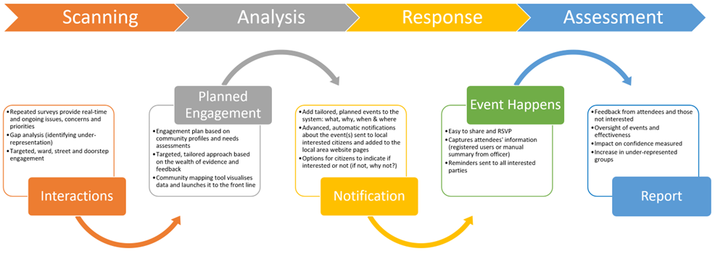
SARA
The Engagement tracker module facilitates a modern approach to understanding communities in the scanning process, targeted, representative analysis, focused responses and accurate assessment in-line with the SARA principles and problem-solving approach.

Slide 5
Simple Tabs
The process is designed to be simple to understand, flexible and speedy to use.
The simple tab structure enables you to access and turn on multiple data sets, immediately visualise the results in map and street form and change your selections at any point.
Localise
Neighbourhood Alert User Data
Police Data
Third Party Datasets
Visualise, Quantify & Verify
Save & Operationalize

Slide 6
Area
Select any area to focus on and explore. From a hyper-local ward to a division, BCU, sector or any area already uploaded to your Alert system.
The starting point on the simple tab structure enables any area to be found and focused on. This localises the results to keep the targeting relevant and accurate.

Slide 7
Information Sources
Survey Responses
Local Issues & Priorities
Confidence In The Police
Groups
Demographics (self-declared)
Own Data
External Data
Age Groups
Recent Burglaries
Origins: Ethnicity & Religious gaps
Fear Of Crime
Legitimacy Views
CCTV Owner
KIN
IAG Member
NW Coordinator
Religious Leader
Community Contact
Sexuality
Disability
Ethnicity
Hate Crime Locations
Power BI Analysis
Incident Locations
Acorn: socio-economic gaps

Slide 8
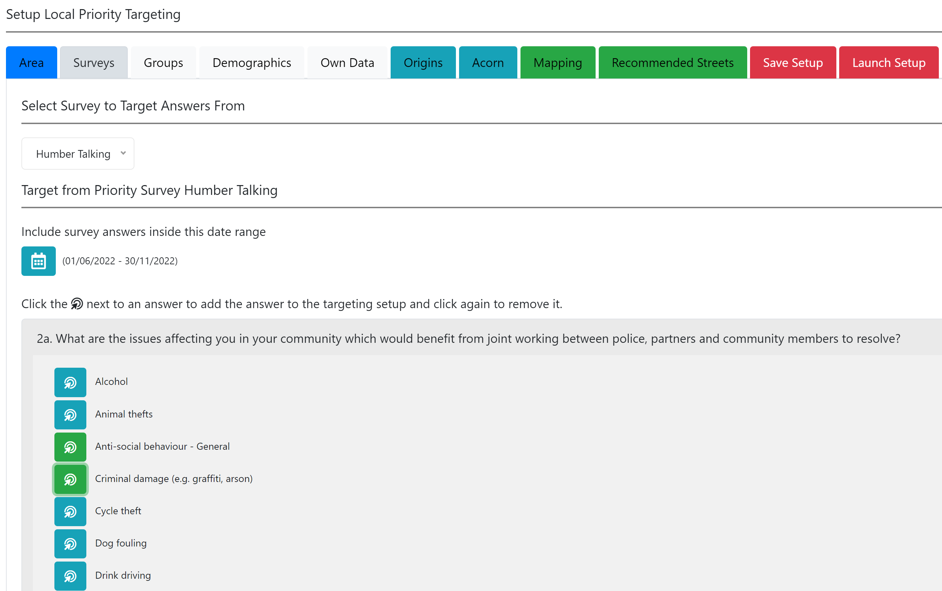
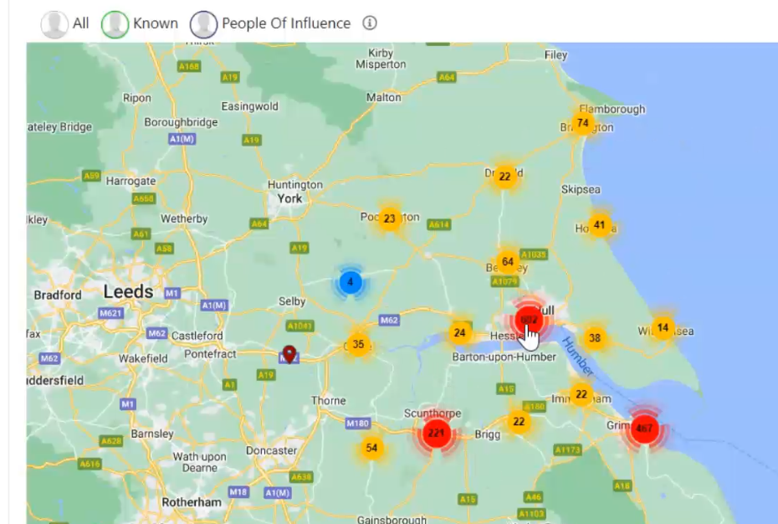
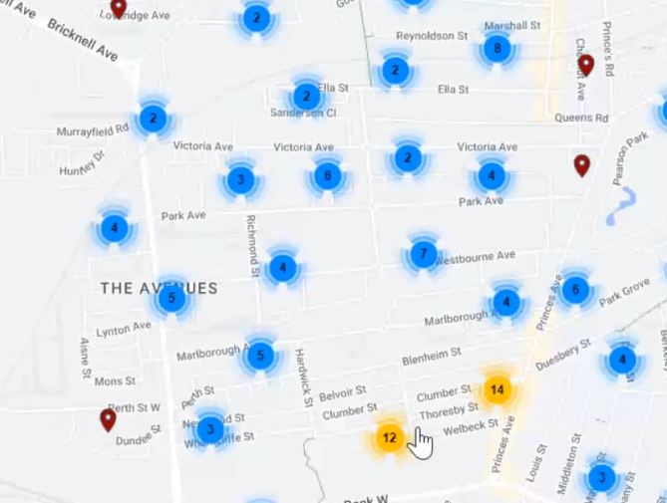
Survey Targeting
Select existing users by how they responded to your priority survey
Locate clusters of responses / hotspots based on issues raised
Drill down to street level and identify specific houses
Find areas of low or high confidence in the police
Raise visibility in areas of self-declared need and issues raised
Filter responses by date range to identify recent or long-standing issues

Slide 9
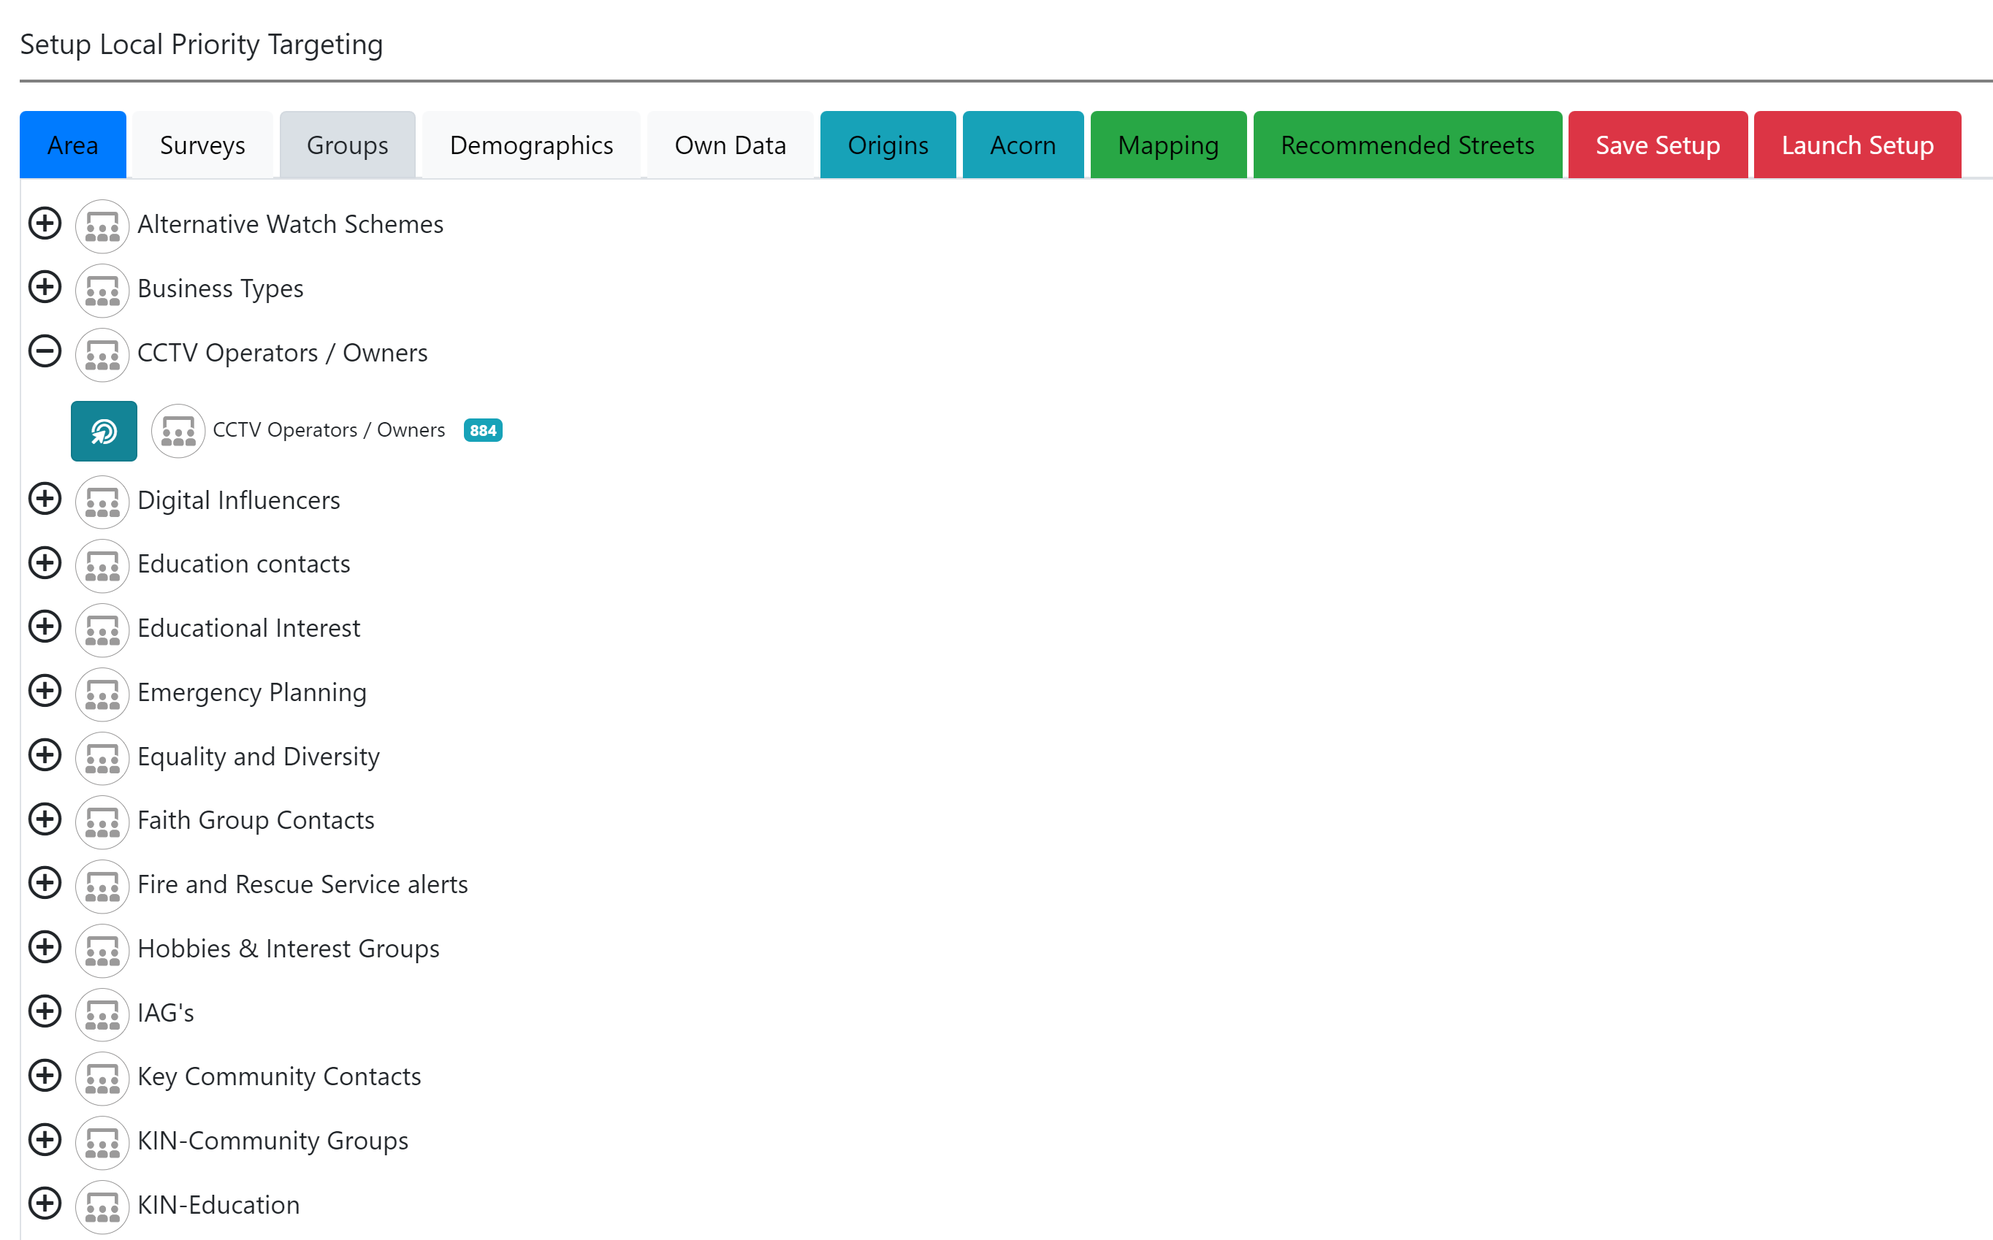
Target By Group
Select existing users by the groups they are part of
Identify CCTV owners for footage enquiries
Keep an accurate record of KINs and IAGs
Groups can be updated instantly by responses given to questions in regular or automated, regular surveys*
Each force has their own custom groups as well as access to several national groups

Slide 10
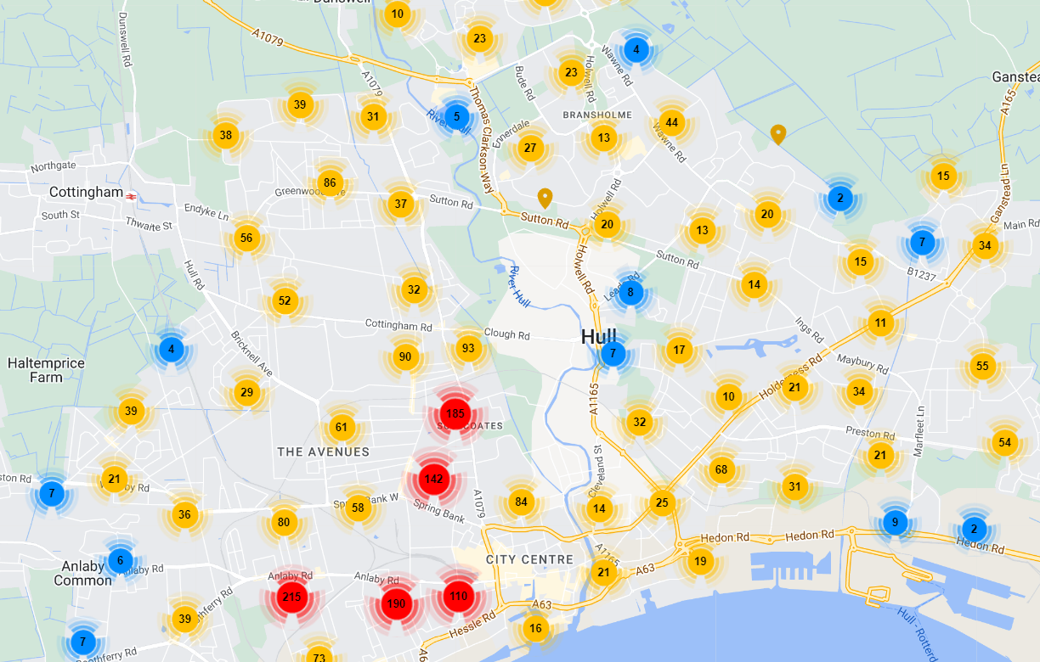
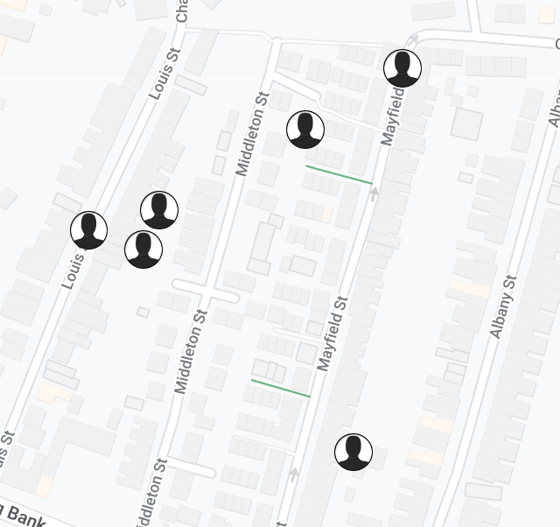
Map
Instantly visualise the various data-sets on interactive maps, see if it matches expectations, identify hot-spots etc.
Zoom in to street and house level.
Registered members are shown as icons including their profile pictures (if uploaded)

Slide 11
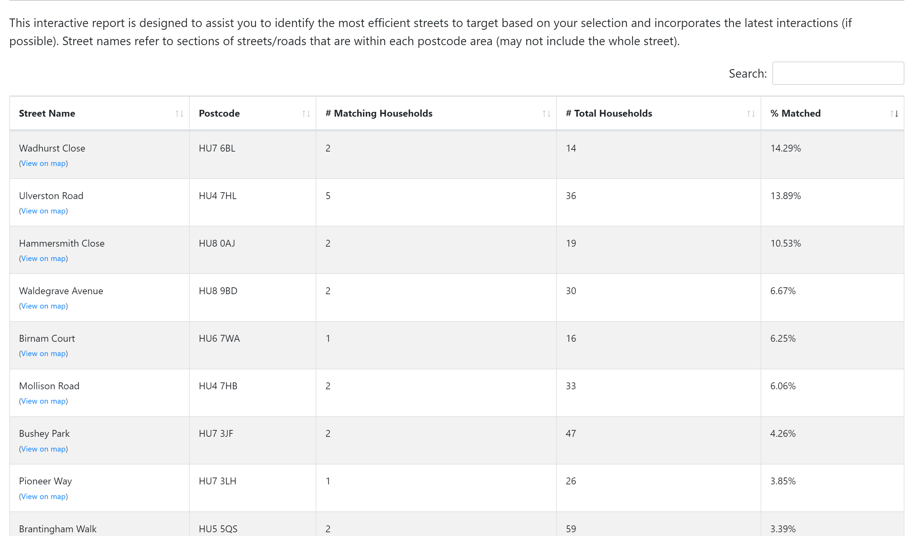
Recommended Streets
Instantly turn the selected data into a list of the streets most likely to return households that match your strategy
An almost instant, evidence based, targeted engagement list
Sort by postcode, priority households and % matched
Provides a local knowledge verification that the right streets are being targeted

Slide 12
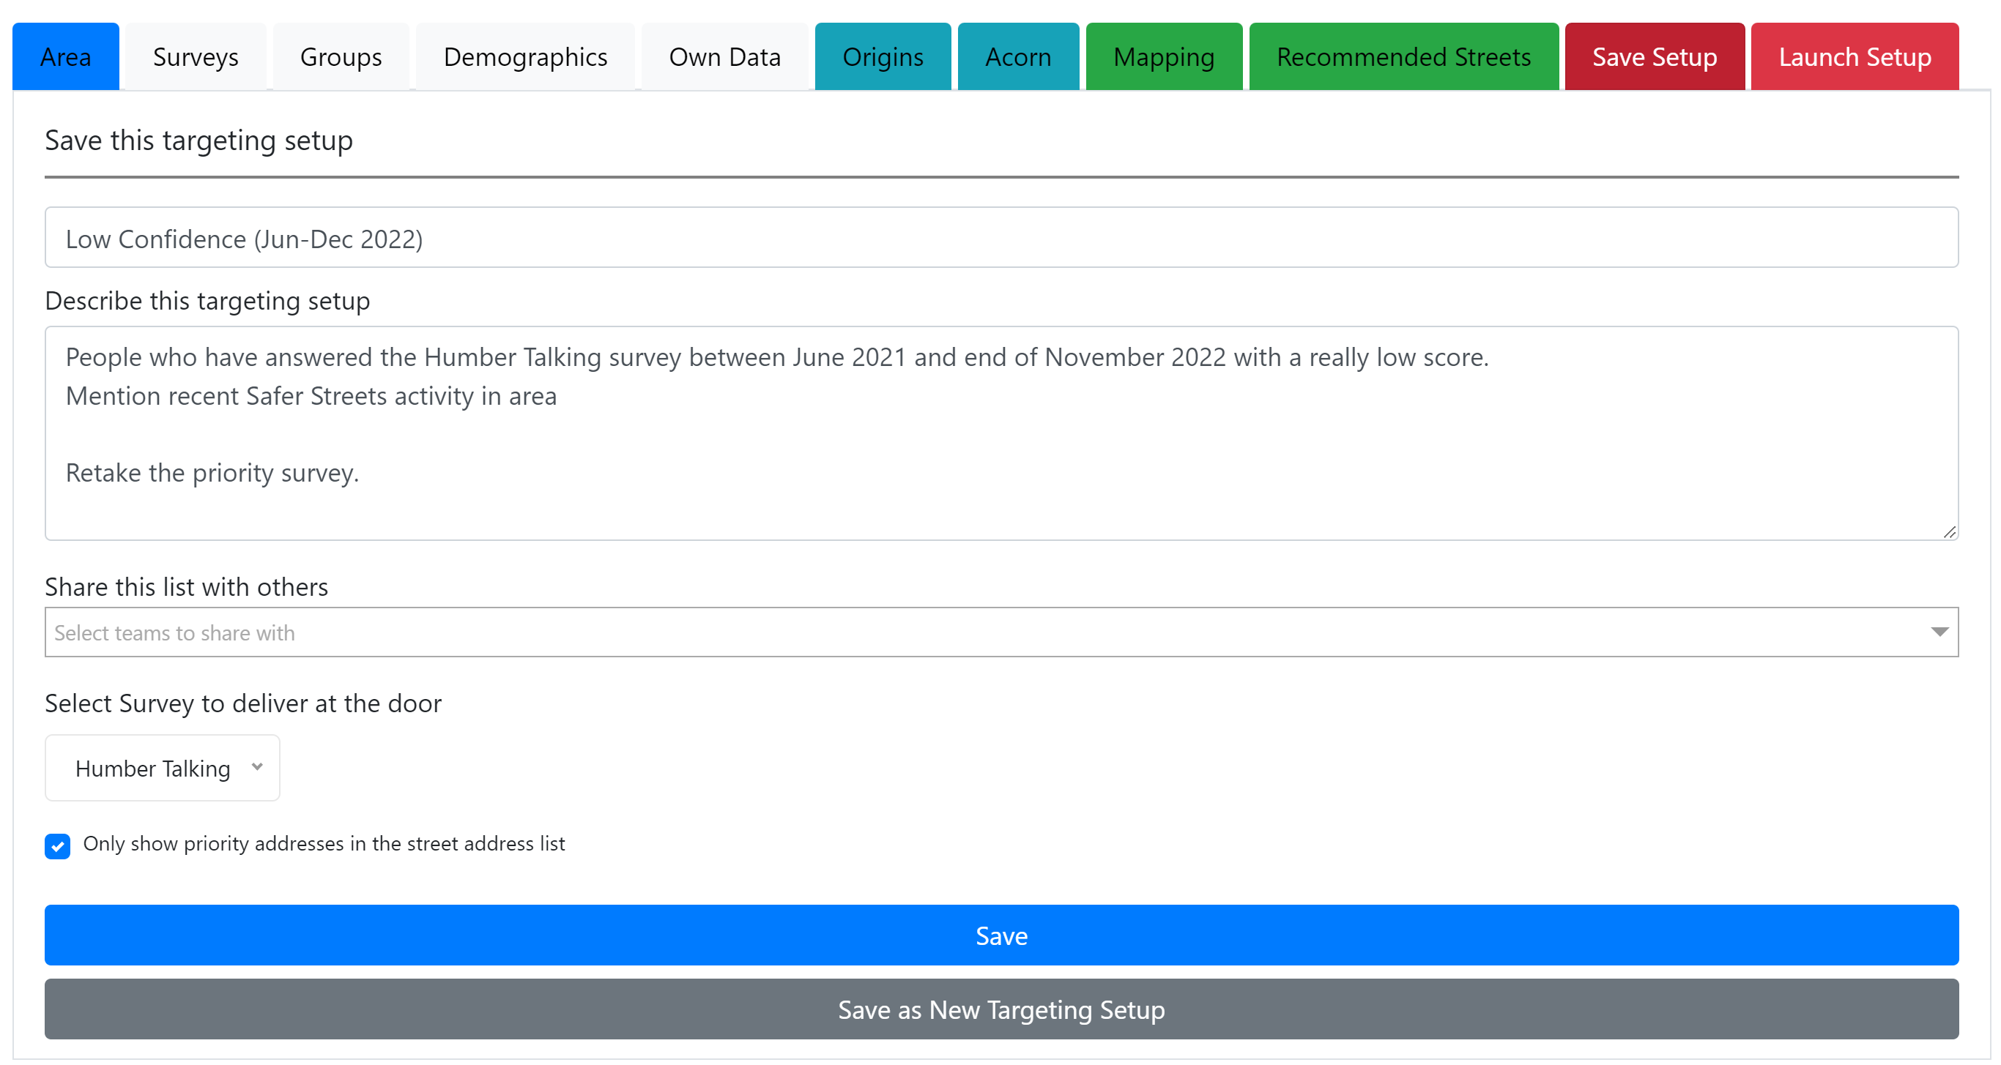
Save your list
Save your list for later modification.
Add guidance to describe the data you have used and why

Slide 13
Configure
Your guidance is propagated to Rapport as advice for officers using the target lists
Select which Neighbourhood Teams this list is shared with
Allocate which survey to deliver to these doors/streets
Decide if every house on each recommended street is listed for contact or only the exact matches. (e.g. Cocooning or Area Hi-Visibility)
Launch your priority list to front line officer devices as simple maps and street lists on Rapport

Slide 14
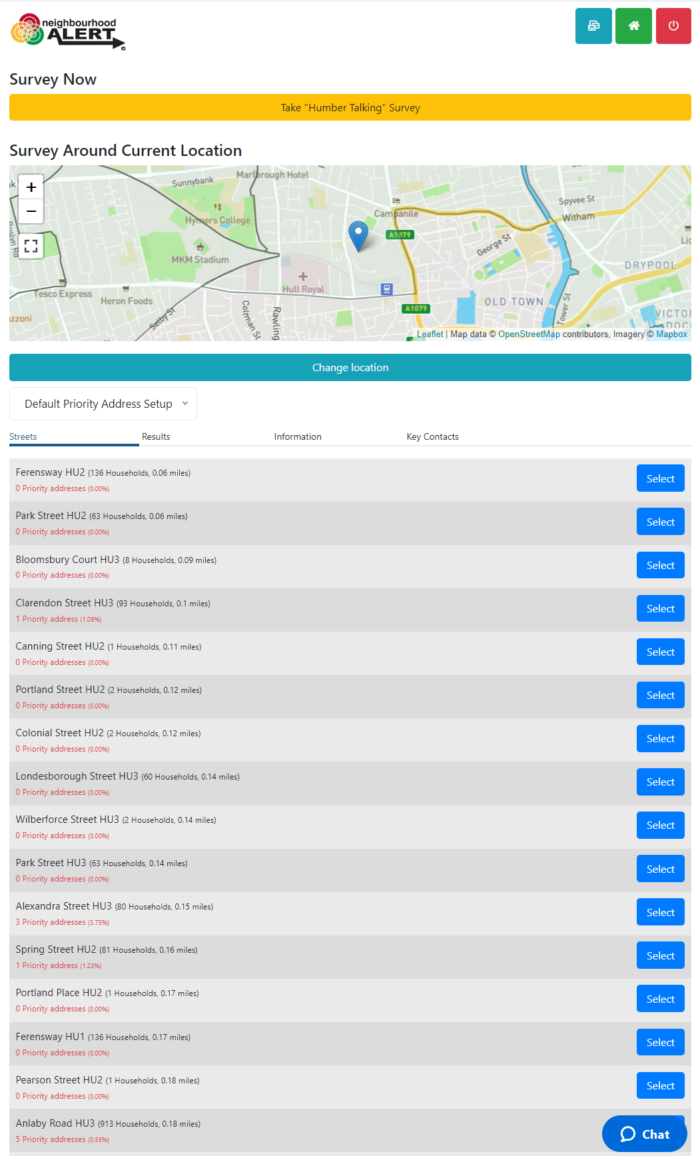
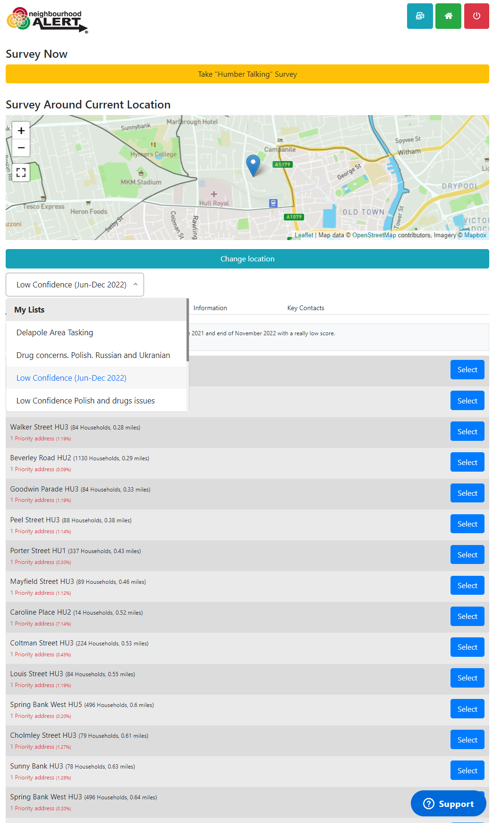
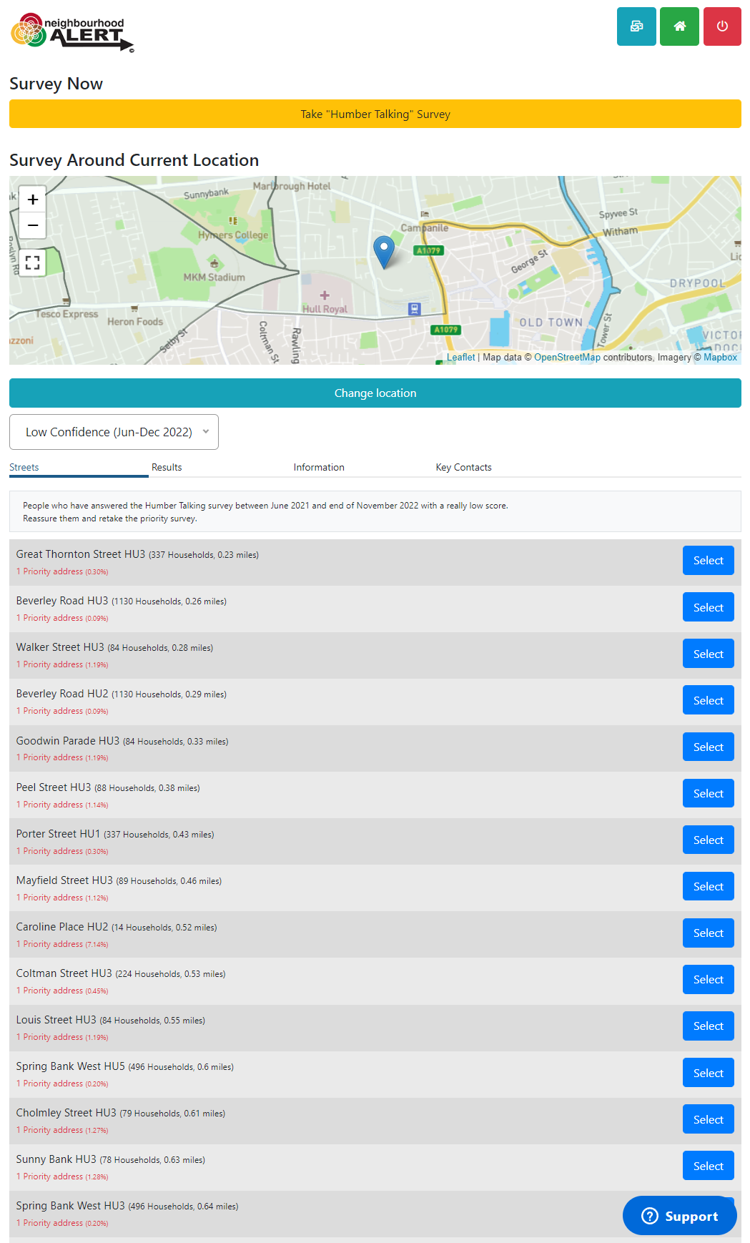
Launch your targets to Rapport
Launch your saved list to make it available for selected teams to view and work from within Rapport
Different streets are presented based on the specific Priority List selected

Slide 15
Interactive, live street list
The system tracks the current location of the officer
Local (private) guidance is provided for officers for each priority list
The streets are ordered by the most efficient locations to visit
Street and house recommendations are based on live (current) data (always up to date)

Slide 16
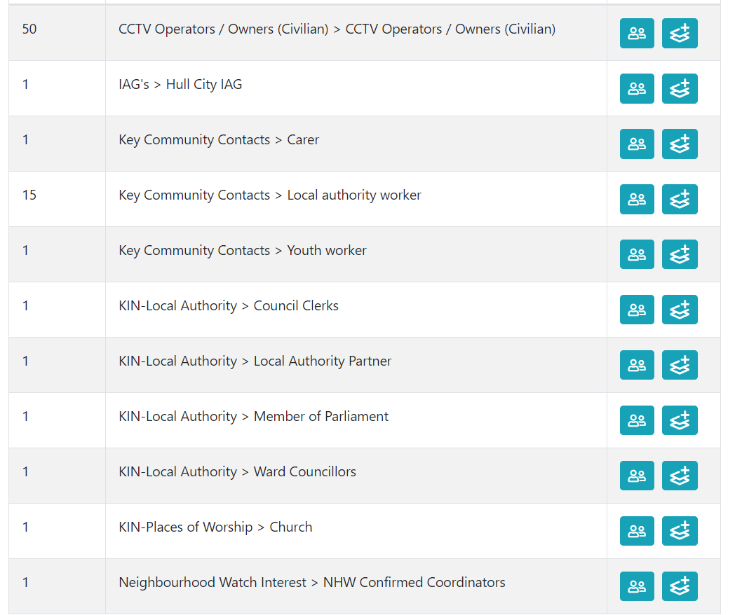
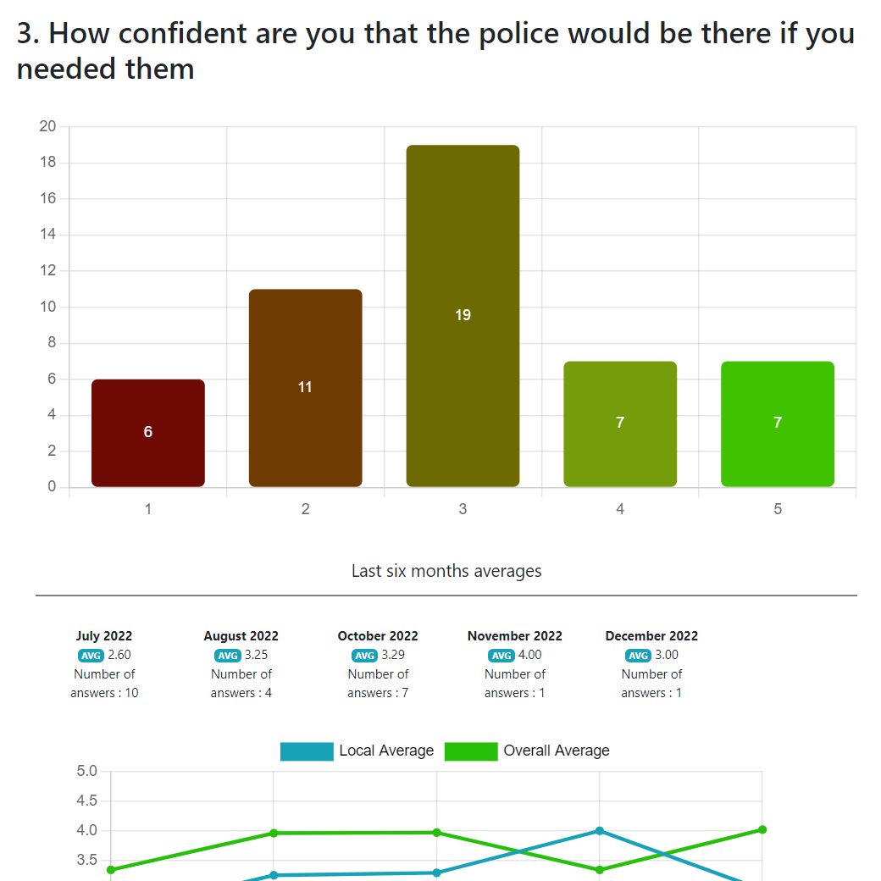
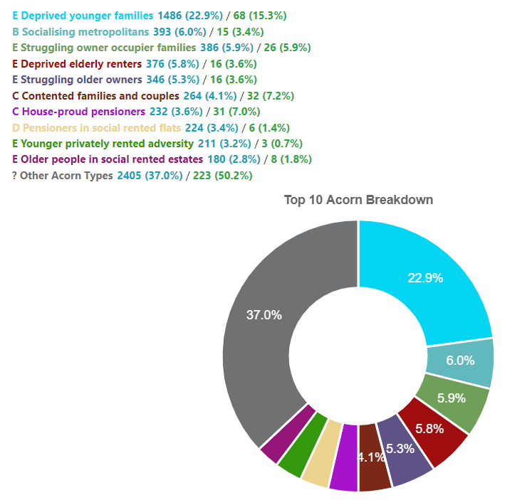
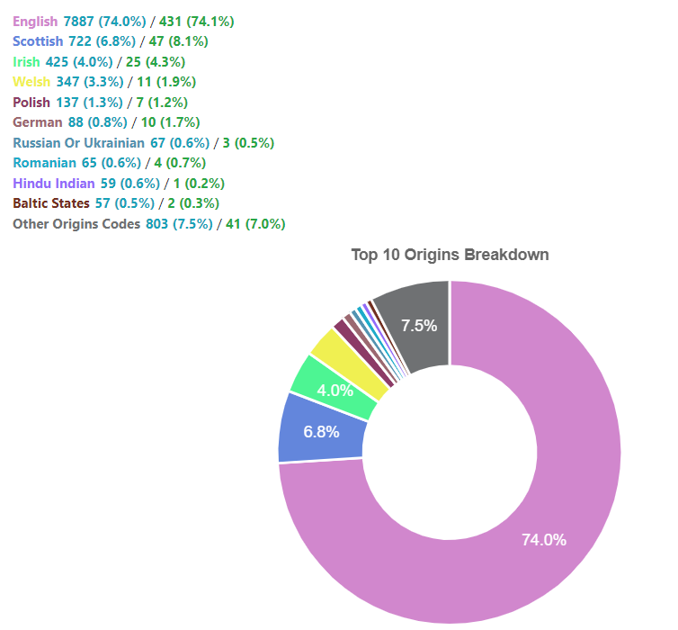
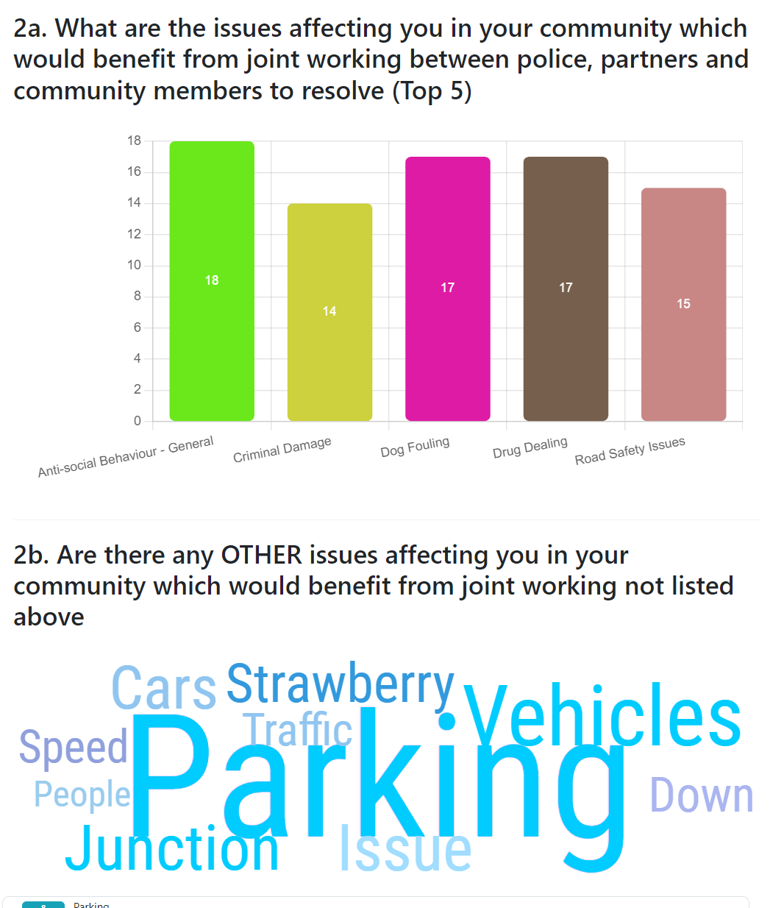
Instant Local Area Information
The module seamlessly works with the enhanced survey module to provide instant access to:
Local Priority survey Results (door to door and self-performed web surveys all in one place)
Local Acorn and/or Origins information (if you have those modules)
Instant access to local key contacts for the area (Coordinators, KINs, IAGs, CCTV and more)

Slide 17
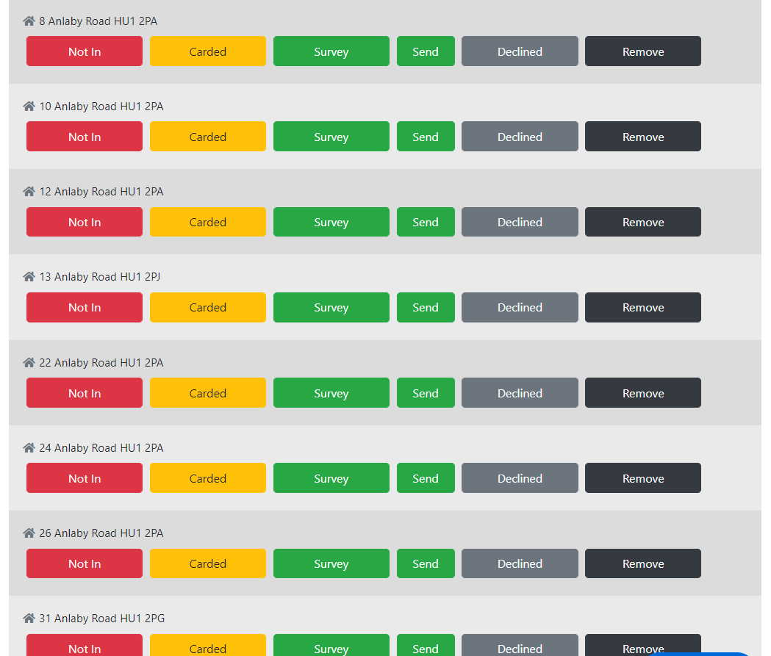
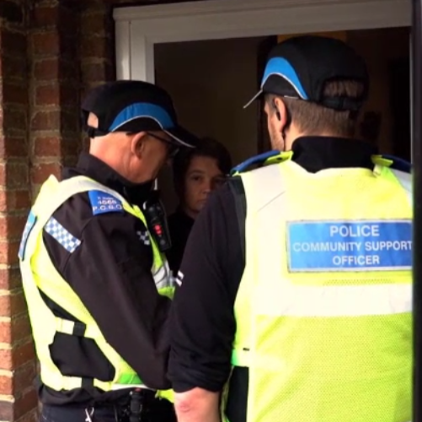
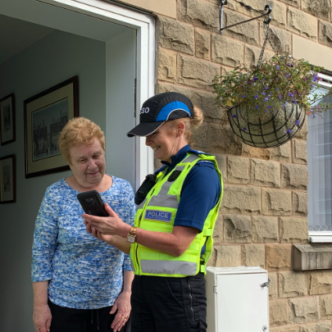
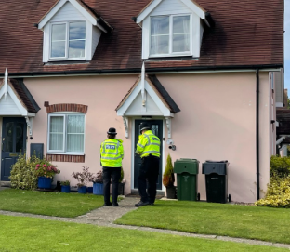
Engage
Targeted door-to-door engagement
Click a street and see the household lists
The list can be set to show only exact matches to the strategy or all houses in the area
Previously completed and recently declined houses are not shown (save time and reputational damage)
All actions are tracked and placed in simple reports

Slide 18
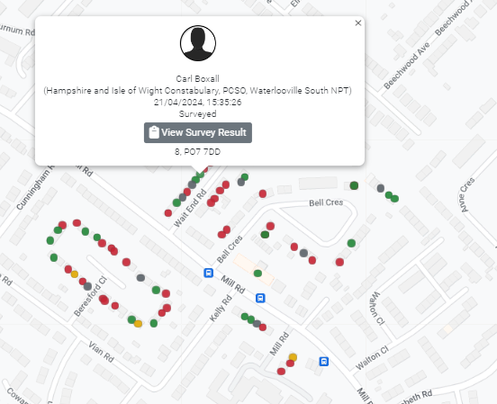
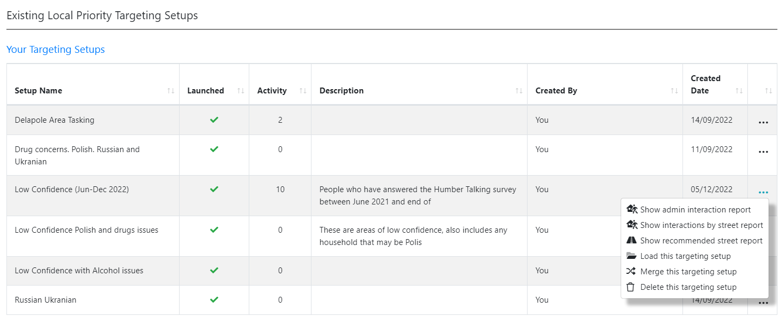
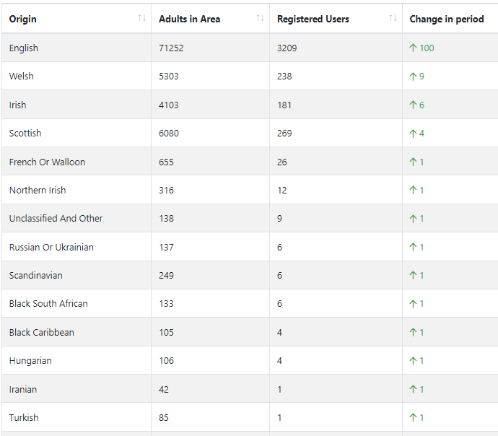
Monitor Results
A huge range of reports enable you to monitor all aspects of team performance, area coverage, public response, ethnic representation and remaining streets.

Slide 19
Further Details
Mike Douglas
Product Director: Neighbourhood Alert
VISAV Limited
( 0115 924 5517 Ext 224
( 0115 8384636 (DDI)
( 07771 557788 (Mobile)
W www.NeighbourhoodAlert.co.uk
/// police.broad.tigers
VISAV Limited, Sherwood Business Centre, 616a-620a Mansfield Road, Sherwood, Nottingham, NG5 2GA Company No: 04511143| Data Protection Registration: Z8862537
Schedule a meeting with me: https://calendly.com/visavmike
Schedule an instant meeting with our technical support team: https://calendly.com/visavsupport

